Slide 1
Kyrgyz State Technical University named after I.Razzakov Telematics Department
Satellite communication systems in India
Turdalieva Aizat

Slide 2
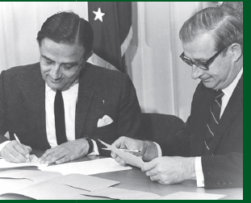
The History and Accomplishments of the Indian Space Program
The Indian Space Research Organization has made the practical uses of space science, rather than prestige, a priority
Uses satellites to search for water and minerals, to map resources, and to monitor the health of its forests
India has planned its first manned space mission for 2015

Slide 3
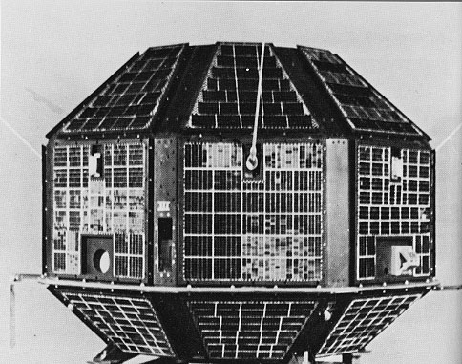
Aryabhata (satellite)
It was launched by the Soviet Union on 19 April 1975 from Kapustin Yar using a Kosmos-3M launch vehicle. It was built by the Indian Space Research Organisation (ISRO) to gain experience in building and operating a satellite in space. The launch came from an agreement between India and the Soviet Union directed by U.R. Rao and signed in 1972. It allowed the USSR to use Indian ports for tracking ships and launching vessels in return for launching Indian satellites.
Bhaskara-I (1979) and Bhaskara-II (1981)
– Experimental Remote Sensing Satellites provided the foundation for the operational Indian Remote Sensing Programme.
The Result is operational Indian Remote Sensing Programme with the launch of IRS-1A on March 17, 1988

Slide 4
The Chandrayaan-1 Moon Orbit Satellite
Its two-year $83 million mission was to orbit the Moon and to map its surface in three dimensions
The mission experienced technical problems
Before a full year was out, India’s space scientists declared the
mission a success
The Indian National Satellite System (INSAT)
The largest domestic communication system in the Asia-Pacific region
Its satellites are geostationary - orbiting at a speed and altitude that keeps satellites in the same place above the Earth at all times
INSAT meets India’s telecommunications, broadcasting, meteorology, and emergency rescue needs

Slide 5
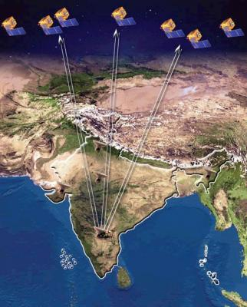
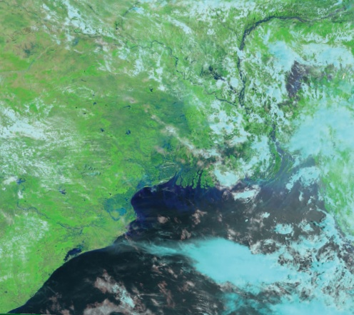
The Mission of Indian Remote Sensing Satellites for Earth Resources
Indian Remote Sensing (IRS) satellite program supports India’s national economy
This constellation of satellites is one of the largest in the world
Indians are using them to study urban sprawl and plan infrastructure

Slide 6
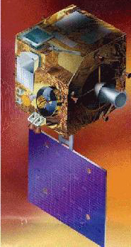
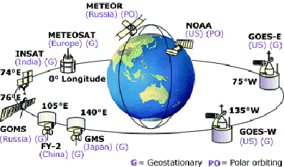
Mission of the METSAT Weather Satellites
On 12 September 2002 India launched the first of a new series of meteorological (weather) satellites called METSAT
Weather instruments impose certain design limits on a satellite
India has more reason than most countries to want the best possible weather data given that Monsoons strike it annually—cyclones and floods too

Slide 7
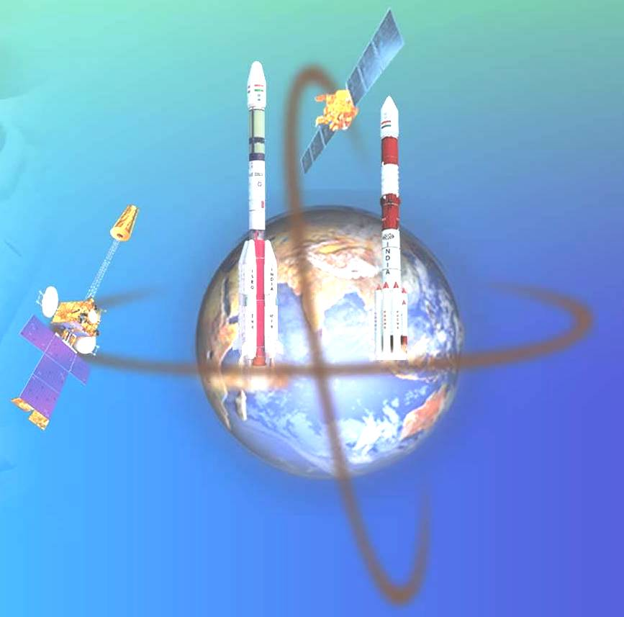
BUDGET
Rs 3,200 Crore
US $ 700 m
HUMAN RESOURCES
16,500 strong
LARGE USER BASE
INTERNATIONAL
COOPERATION
IRS
ACADEMIA & INDUSTRY
SPACE COMMERCE
INSAT
Space Assets -
Remote sensing &
Telecom satellite
Constellations
LAUNCHERS
STATE OF THE ART TECHNOLOGY
INFRASTRUCTURE
End – to - end capability
INDIAN SPACE ENDEAVOUR

Slide 8
FOUR DECADES OF INDIAN SPACE PROGRAMME

Slide 10
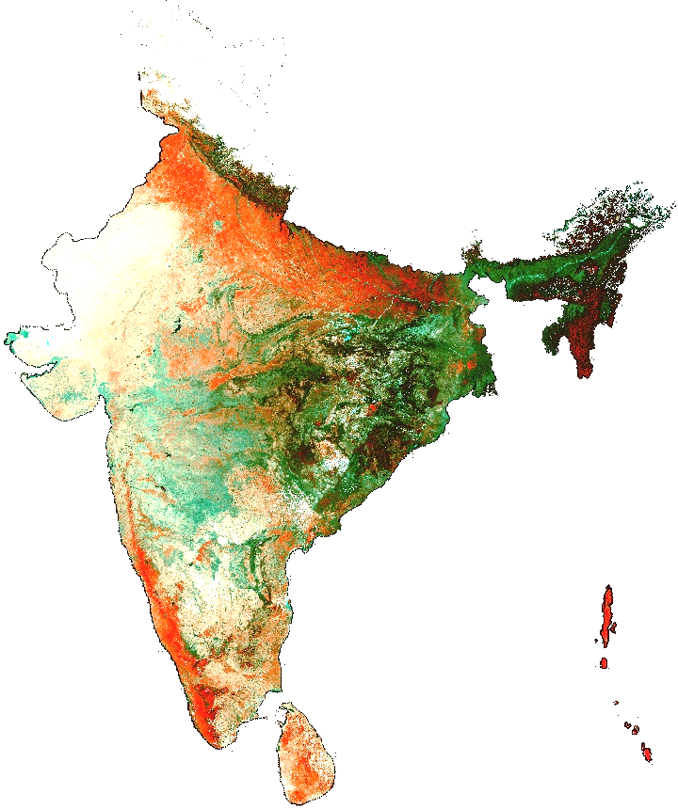
EARTH OBSERVATION – APPLICATIONS
AGRICULTURE & SOIL
Crop Acreage & Production Estimation
Soil & Land Degradation Mapping
Watershed Development
Horticulture Mission for North-East
FOREST, ENVIRONMENT, BIO
Forest Cover & Type Mapping
Forest Fire and Risk Mapping
Biodiversity Characterisation
Environmental Impact Studies
WATER
Potential Drinking Water Zones
Command Area Management
Reservoir Sedimentation

Slide 11
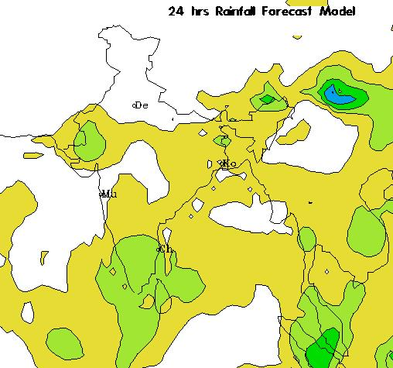
EARTH OBSERVATION – APPLICATIONS
OCEAN
Potential Fishing Zone (PFZ)
Coastal Zone Mapping
DISASTER SUPPORT
Flood Damage Assessment
Drought Monitoring
Land Slide Hazard Zonation
LAND
Landuse/Land Cover Mapping
Wasteland Mapping
Urban Sprawl Studies
Large Scale Mapping
WEATHER & CLIMATE
Extended Range Monsoon Forecasting
Ocean State Forecasting
Regional Climate Model

Slide 12
OPERATIONAL COMMUNICATION SATELLITES

Slide 13
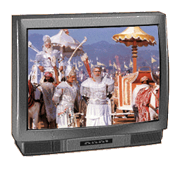
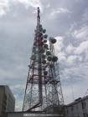
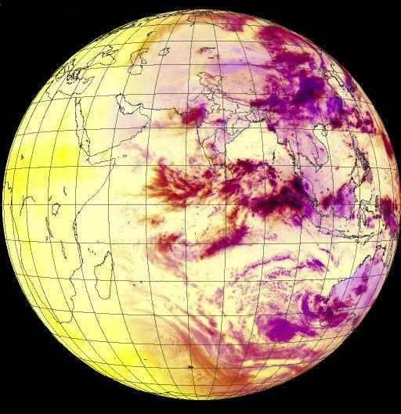
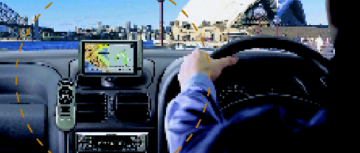
Indian National Satellite (INSAT) System
Commissioned in 1983, INSAT is a multipurpose satellite system for telecommunications, television broadcasting, meteorology, disaster warning and search and rescue. Besides telecommunications and regular broadcasting services, INSAT is widely used for interactive education, developmental communication and telemedicine. Meteorological imaging and direct-to-community broadcast capabilities of INSAT help in issuing warnings on impending cyclones. INSAT also carries transponders dedicated to search and rescue operations as part of international COSPAS/ SARSAT programme.
BROADCAST
Television Broadcasting
Direct To Home (DTH)
TV & Radio Networking
METEOROLOGICAL
Meteorological Imaging
Data Collection Platform
Disaster Warning
COMMUNICATION
OTHERS
Mobile Satellite Service
Search and Rescue
Satellite Navigation
Speech Circuits On Trunk Routes
VSAT Connectivity

Slide 14
Tele-education
In 2002, ISRO in consultation with various agencies came up with a report ‘Educating the Nation
– Need for a Dedicated Satellite’. This report argues that education in the Indian context requires “a large number of channels and a dedicated satellite”. The report notes that the challenges for the India in the field of education are “complicated due to the pluralistic culture of multiple religion, language, customs and mores……..that of numbers and of quality. Indeed, the challenge is meaningfully educating a one billion strong nation on a continuing basis” Subsequently the EduSat project was conceived by ISRO in consultation with MHRD.
Tele-education programme of ISRO, through INSAT/GSAT series of satellites, supports
Services through audiovisual medium employing digital interactive classroom multimedia, multi-centric system
• Sustainable Distance Education Service
• School, college and higher levels of education and nonformal education

Slide 16
Teaching End
The teaching end consists of a small studio and an uplink earth station. The studio, which
originates live or recorded lectures, is linked to the uplink earth station. The lectures (visual images and the audio signal) are transmitted to the satellite from where they are beamed back to earth covering a large geographical area, for example, entire Punjab. The 6.3-metre antenna for uplink has been installed in Govt. Polytechnic College for Girls, ROPAR (Punjab). Presentation PC, DVD player and Digital camera are attached to the switcher and the switcher is used to select which of signal come among Presentation PC, DVD player and Digital camera etc. The presenter PC has a digital monitor that can be used as a ‘White Board (Not Black Board!)’.
Teacher can write texts or draw pictures using a digital pen on this white board and this image also can be transmitted to students end. A mic is directly attached to Server. Finally the mixed output sends to the modem through server computer.

Slide 17
Receiving End of Classroom
The live lectures are received at classrooms of the engineering and polytechnic colleges. There are two types of classrooms - interactive and non-interactive. The 1.2-meter antenna has been installed in each college. In the interactive classroom, the students can interact with the subject expert at the teaching end through a voice link via satellite (64 kbps audio return channel).The question and the subject expert's response to the question can be heard live in all classrooms. Oninteractive classroom will have 'receive-only' facility and the students can interact with the subject expert via telephone line or mobile phone or internet.
Spacecraft
EduSat, world’s first satellite meant only for educational purposes, is being used.

Slide 18
By end 2012, 60 specialty hospitals in major cities connected to nearly 311 hospitals at rural and remote areas and 18 mobile telemedicine units

Slide 19
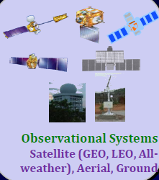
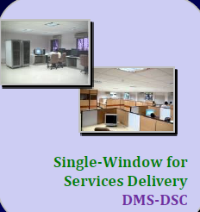
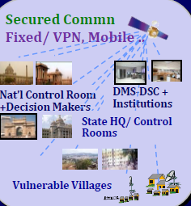
DISASTER MANAGEMENT SUPPORT (DMS) SYSTEM

Slide 20
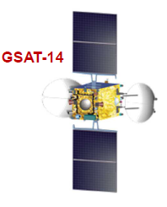
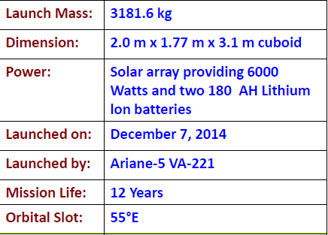
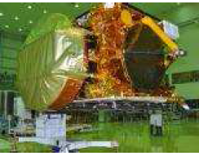
Advanced Communication Satellite

Slide 21
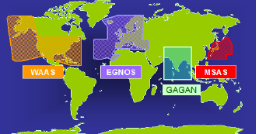
GAGAN : Augmented Navigation
• GAGAN : GPS Aided GEO Augmented Navigation
– Jointly implemented by ISRO & Airports Authority of India
• Configuration
– Ground Component (15 ref st; 3 uplink stn, 2 control stn)
– Space Segment : Payloads on GSAT8 & GSAT10
• Certification
• Indian aviation regulator DGCA issued certification for RNP0.1
(Required Navigation Performance, 0.1 Nautical Mile) service level on December 30, 2013.
• Interoperable global system

Slide 22
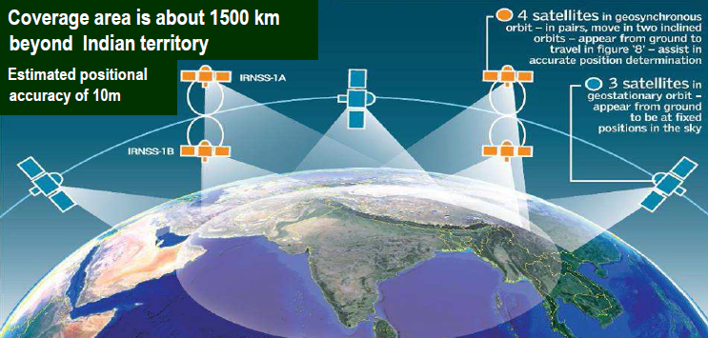
Satellite Navigation – IRNSS (Indian Regional Navigation Satellite System)
An Indigenous navigation system of seven-satellite constellation designed for
providing position, navigation and timing services over Indian region
• Three satellites are already in orbit; 4th Satellite to be launched in March 2015
• Constellation is planned to be completed by 2015

Slide 23
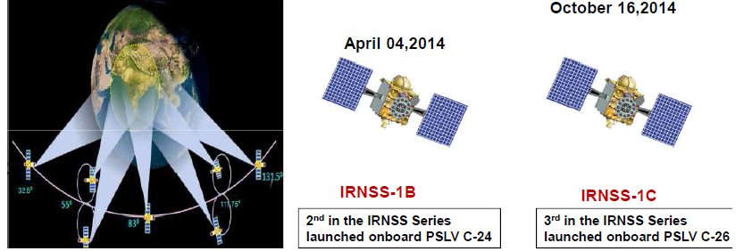
Navigation Program : IRNSS
– 7 satellite configuration (3 geostationary; 4 geo-synchronous)
– IRNSS-1A was launched on Jul 1, 2013
– Two satellites IRNSS-1B (Apr 4) and IRSNSS-1C (Oct 16) launched in 2014
– IRNSS Signal-in-Space Interface Control Document (ICD) for
Standard Positioing Service (SPS) released

Slide 24
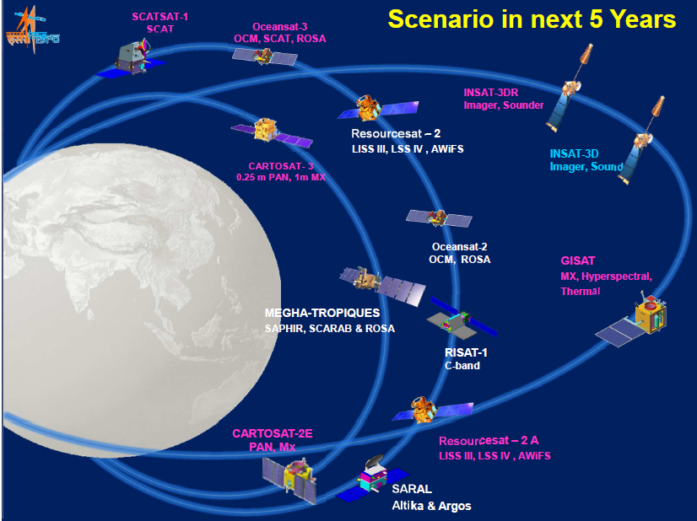

Slide 25
Thank you for Your Attention!

