Slide 1
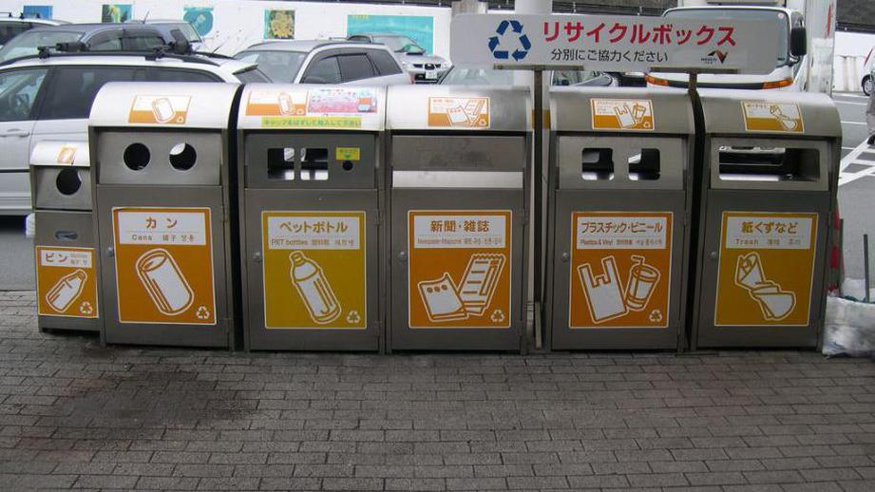
Sorting and Recycling of Waste in Japan

Slide 2
In Japan, the problem of waste disposal is particularly important because there is limited space for landfills on the islands. Precisely for this reason, the Japanese have long developed system for sorting and recycling garbage and also came up with a special “waste-free” philosophy.

Slide 3
Four Types of Garbage Here, garbage is segregated into four different bins incombustible, combustible, recyclable and oversized. Moreover, for each type of waste, special bags of a certain color and volume are intended to make it easier to distinguish which type of waste is in them. For oversized garbage, which, naturally do not fit into the bags, special stickers are used.

Slide 4
To make sure that everything was sorted correctly, the workers monitor and inspect them. The garbage truck arrives at certain hours, and by this time, the residents have taken out their bags; moreover, since they are transparent, the inspectors will have the opportunity to check whether the waste has been properly sorted. If they are not sorted correctly, the packages are not collected. The garbage truck arrives not only at certain hours, but also on certain days. Each type of waste is collected exactly on the appointed day of the week, on the day directed by the municipality.

Slide 5
So for example, in the city of Kita-Kyushu, on Tuesdays and Fridays, combustible garbage is collected, on Wednesdays - cans and bottles, and on Thursdays - plastic packaging. If you take out, say, on Tuesday, plastic trash, they simply will not accept it. If you leave all kinds of trash for the garbage truck, the entire housing facility will be fined.

Slide 6
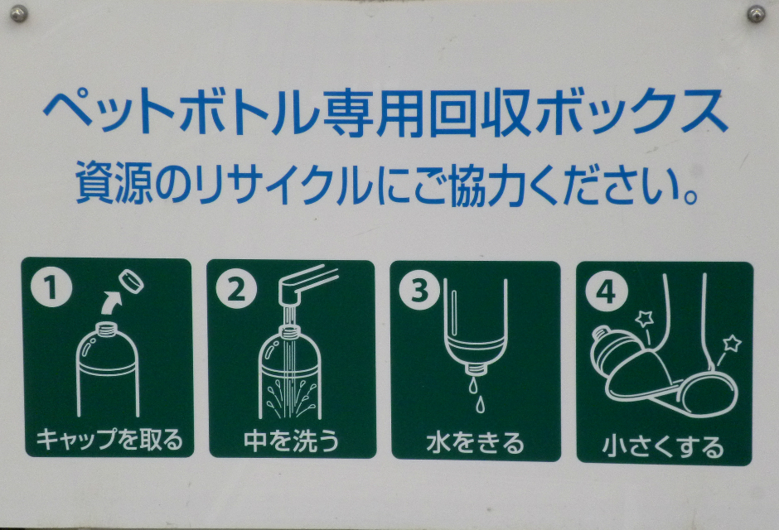
Fee for Old Equipment The day for the removal of oversided garbage is usually appointed separately: residents call the garbage collection company and make an appointment. Then, they are told when the garbage truck arrives for collection. You must then pay for its disposal separately. For example: recycling household appliances gives the country more than 1 million tons of iron and 50 thousand tons of non-ferrous metal per year. Attempts to throw away unnecessary equipment and electronics without payment will result in fines of several hundred dollars.

Slide 7
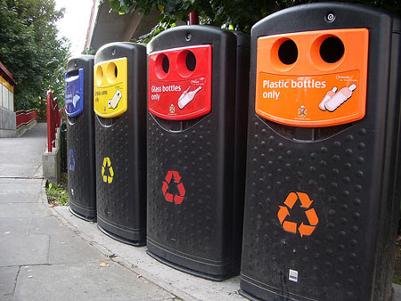
Waste Segregation
To ensure that the guests of the country also observe the rules of segregation, the Japanese set special bins with holes of varying sizes on the streets to make sure that nothing more than the intended trash is disposed there. For example, if the bin is for tetra packs, you cannot squeeze a glass bottle into it. In order to make it clear as to which category of waste a certain waste belongs, there is are labels on all products telling you what category it is. For example, on yogurt, it is indicated that the lid should be thrown into plastics bin, and the glass into combustible waste bin.

Slide 8
Waste Incineration
A lot goes into combustible waste. Even paper, 80% of which the Japanese hand over for recycling, is only 63% recycled. The rest is burned, like most of the other garbage. Japan has the most modern technology is used - plasma gasification. Through this technology, solid waste is treated with a plasma flow with a temperature of more than 1200 ºС. At this temperature, the resin is not formed, and toxic waste is destroyed. From 30 tons of garbage, only 6 tons of ash remains, which is then cleaned and used in construction.

Slide 9
At the same time, the plant not only destroys garbage, but also produces electricity, which is supplied to urban houses, baths, and swimming pools. In general, such an attitude towards the waste recycling industry is formed in a society where institutions cooperate with one another. So parks and squares are laid out near the waste recycling plants, and the companies themselves do excursions and lectures for schoolchildren in them. Some objects of the garbage industry are even considered as architectural heritage.

Slide 10
Islands Made from Garbage
Slag formed during the incineration of garbage is used in construction. It is pressed into huge bricks, from which buildings and even islands are then built. The most famous of them is the artificial island of Odaiba in Tokyo Bay, on which the elite residential complex is located. Generally, on such islands they construct anything they want: housing, parks, factories, airports; in general, they increase the size of the state at the expense of former garbage.

Slide 11
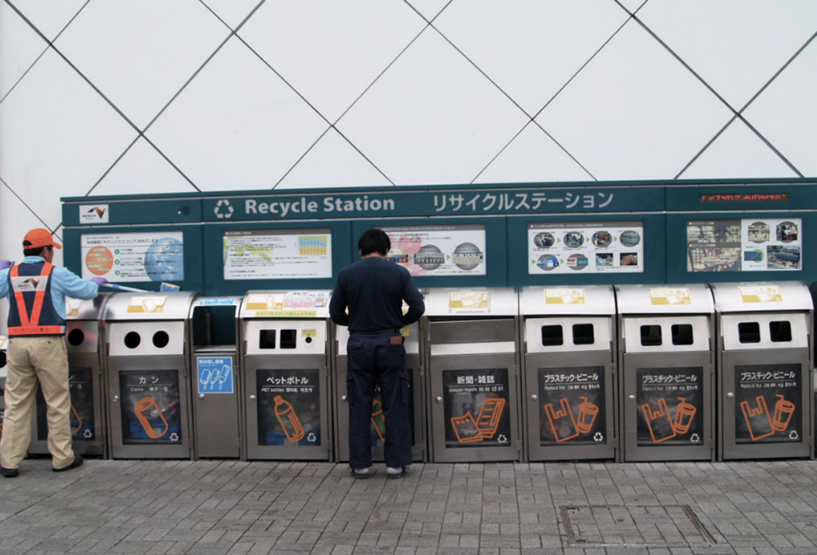
The “Mottainai" Philosophy
Japan recycles 90% of its waste, but is still concerned about its quantity. According to statistics, the average Japanese produces about a kilogram of garbage every day. Realizing that it was impossible to recycle everything, the Japanese decided to take an example from other countries and implement the “zero-waste” program. Its purpose is to minimize not only waste, but also generally used materials. In the community, they spread the idea of ​​“mottainai”, which says: “Do not throw it away until you have used it completely.”

Slide 12
Green Tokens to Reduce the Use of Plastic Bags
Reducing the consumption of plastic bags is one of the important directions of the “mottainai” movement. The government of the country began to promote their economical use. Now, the stores do not give the bags by default, but first, they ask if the buyer needs it. In some supermarkets, the buyer may take a special green token at the entrance and put it in his shopping basket, so he will let the seller know that he does not need the bags.

Slide 13
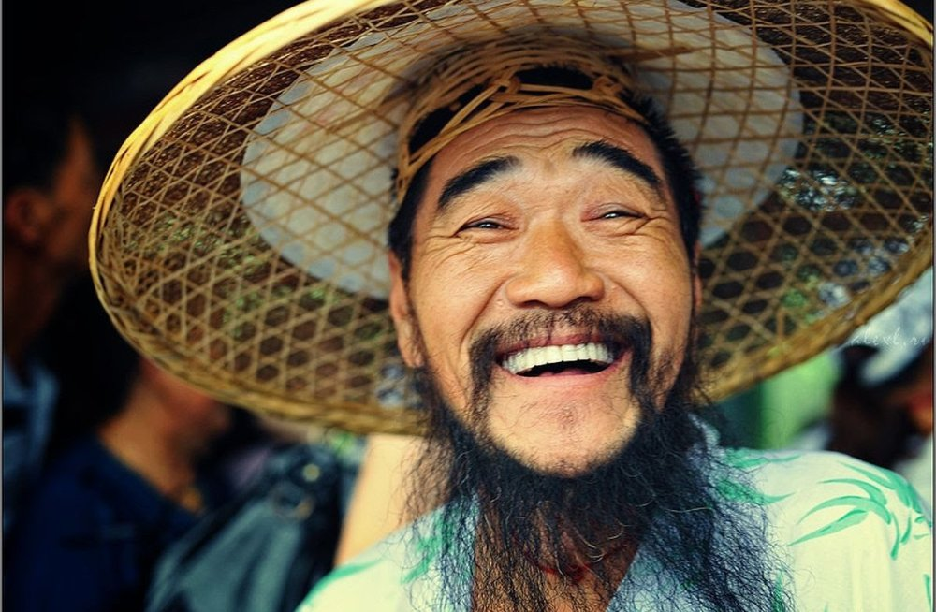
Thanks for attention)))

