Slide 1
Kyrgyz State Technical University named after I.Razzakov Telematics Department
The history of the telemedicine development in Asia Pacific countries
Sultangazieva Rena

Slide 3
The "Asia Pacific region" is defined as those countries and areas of Asia and the Pacific that lie substantially between the longitudes of 30 degrees east and 170 degrees west, being the countries and areas listed below. On the map, this region stretches from Egypt in the west, to the Cook Islands in the east, and from Russia in the north, to New Zealand in the south.
Huge population
Medical standards are so different due to diversity of cultures, races, and religions
There are specific diseases in Asia, such as chicken flu, SARS, and genetic disease, etc
Little time difference and short distance among countries
In some developing countries, there is a complete lack of standardized healthcare in remote communities.

Slide 4
Asia- a major player in Telemedicine
- International Journal of Medical Informatics:
Special Issue: Telemedicine in the Asia Pacific, Vol 61, Issues 21-23, 2001
ITU - active telemedicine player in Bhutan, Vietnam and Thailand
Japan - National Cancer Center connecting to 14 sites, 130 teleconferences/year
China, Hong Kong – Hospital Authority developed clinical management system supporting eHR, decision support since 1995; eSARS system in 2003 to combat SARS.
Malaysia – Telemedicine Flagship Project provided integrated health services since 1996
Singapore – iN2015(10 year master plan), personal health records, integrated healthcare, decision support, data collection and sharing for biomedical and health services research
Taiwan – Rural telemedicine(1996), Healthcare smart IC card, ubiquitous healthcare, National health informatics project planning

Slide 5
Korea-Japan Cable Network (2001)
Medical care level in Asia- Pacific area is varied among countries because of a disparity in economic power and differentials in policies, religions and
customs. The medical information does not distribute easily beyond the borders, and they usually are not aware of even the existence of the differentials in medical care.
The distribution of medical information with Internet beyond the borders makes medical staffs keenly aware of the differentials, and uncovers the relative advantage and disadvantage in the medical field in each country. By remote inspection into the hospital through internet, medical doctors can confirm the advantage of the new techniques and technology before they induce them into their hospital with a heavy cost. For these purpose, they have been establishing the Asia-Pacific international medical network with medical quality moving image by information technology

Slide 6
Korea-Japan Cable Network
The Hyeonhae/ Genkai project was established to use the Korea-Japan Cable Network (KJCN) for development of informatics research and friendship between Korea and Japan in 2001. In 2002 Japan and Korea hosted the FIFA World Cup, then an undersea fiber optic cable was laid between Busan and Fukuoka to opening a high-speed internet connection. As a subproject of the Hyeonhae/ Genkai project in medical field, they started to use KJCN for medical teleconference and remote medicine. They connected the first network between Hanyang University and Kyushu University Hospital on 2003, and the second network between Korean National Cancer Center (NCC) and Kyushu University Hospital. The distance between Kyushu University Hospital and APII Genkai Network Operation Center (NOC) is about 10 km. The KJCN cables lay submarine between Busan and Fukuoka. The distance between Busan Landing Station and Fukuoka APII Genkai NOC is about 300 km.

Slide 7
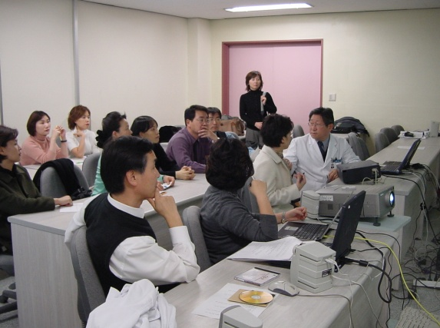
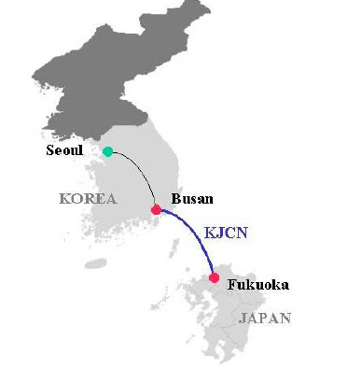
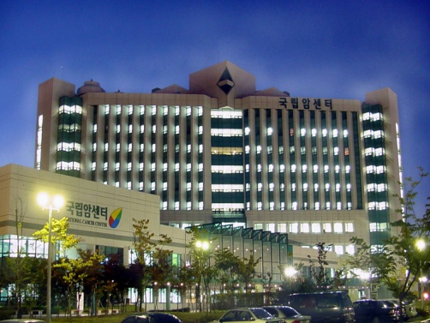
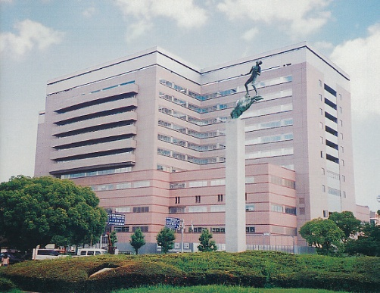
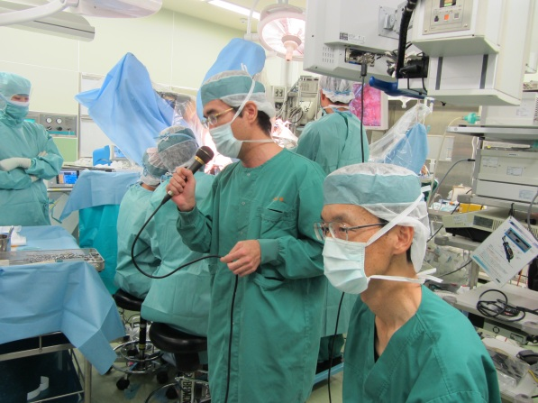
Korea
Japan
Hospital introduction
Endoscopic discussion
Surgical techniques
Kyushu Univ

Slide 8
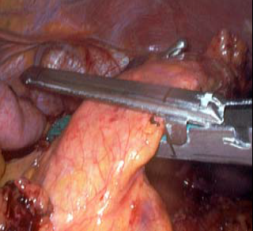
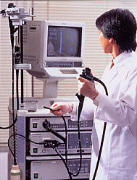
Korea-Japan Cable Network
They set up teleconference system and streaming system of recorded video image with bi-direct transmission using Digital Video Transport System (DVTS) on internet protocol on the network described above. The system can be set up only with a digital video camera and a personal computer connected via an IEEE 1394 interface. The minimal requirement for digital video transmission for telemedicine is 30 Mbps with DVTS per channel
Before its construction, no network was available between the two countries for high-quality moving images. Now DVTS is an open source free ware supported by WIDE project

Slide 10
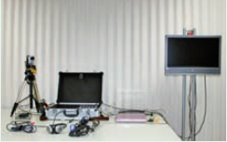
DVTS: Digital Video Transport System ( Digital Video over Internet Protocol )
1. High quality video No compression of images
2. Little time delay No compression process
3. Less expensive Commercially available standard PC and DV camera
4. System is simple Direct connection between DV and PC (IEEE1394)
Academic network (Research and education network)
- APAN
- TEIN

Slide 11
Telemedicine Development Center of Asia, (TEMDEC) based at Kyushu University Hospital in Fukuoka, Japan has facilitated remote training of surgeons, sharing of knowledge and the spread of best practice across the Asia-Pacific region, and more recently globally, by using SINET (Japan’s national research and education network) and the global network of national research and education networks- Asia Pacific Advanced Network (APAN) (2004);
Each country has its own domestic research and education network (REN); these networks are connected by international RENs. International networks have been established that connect these domestic networks, such as the Asia-Pacific Advanced Network (APAN) and the Trans--Eurasia Information Network (TEIN3). Academic networks also exist worldwide outside the Asia-Pacific region, such as GEANT2, which connects more than 3500 institutions across 34 countries in Europe.

Slide 12
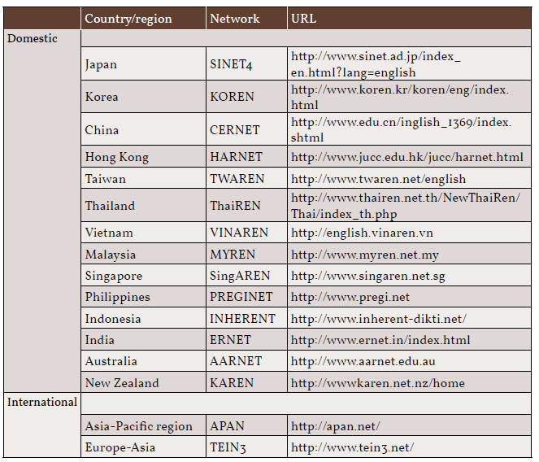

Slide 13
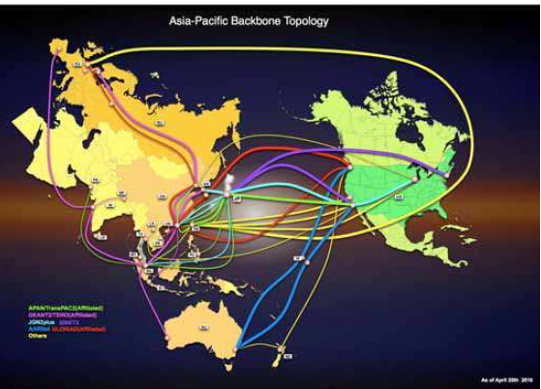
APAN provides the transit service for other
international R&E networks

Slide 14
At the 17th APAN Hawaii Meeting on January 26 and 27, 2004, experiments were performed connecting Korea, Japan, and Hawaii by IPv4/v6 protocol. The experiments included demonstrations of IP-control car racing, Ruff Systems HDV transmission, HDTV telemedicine, and multicast DVTS delivery.
The APAN is an active organization working for an active collaboration among countries with big broadband network (at least 1 Gbps) like Japan (APAN-JP), Korea (KARN), Singapore (NUS- Singarean), EU and USA (Internet 2). After an initial setup project started in August 2005, a successfull linkup, beaming live surgery, has been realized in October between our Centre (MISC) in Singapore (NUS) and Japan (University of Kyushu) and South Korea (University of Seoul in Bandung).

Slide 15
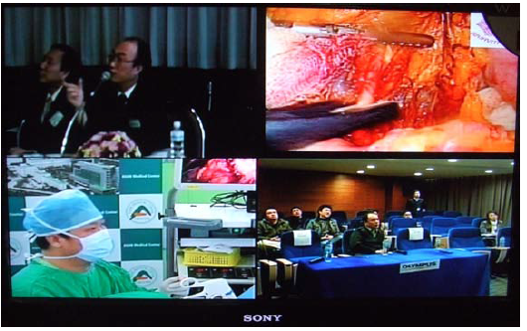
Two simultaneous operations were sent from Fukuoka, Japan (right, top) and Seoul, Korea (left, bottom) to Bangkok, Thailand (left, top) and Shanghai, China (right, bottom).

Slide 16
This project on “Medicine over Internet” will certainly improve exchanges in the medical communications among different Asia-Pacific Countries in spite of their location, political boundaries and expertise. The medical knowledge will be a platform for case-discussion, proctoring and mentoring in the Asia-Pacific area. The difference in medical care level and medical social system varied all over Asia because of disparity in economic power and differences in policies, religions and customs. The development of broadband together with the use of DTVS will allow us to spread out medical information with Internet beyond the border. Exchange and confrontation will be easier, cheaper and easily available.

Slide 17
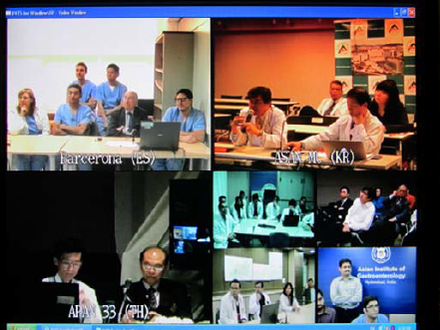
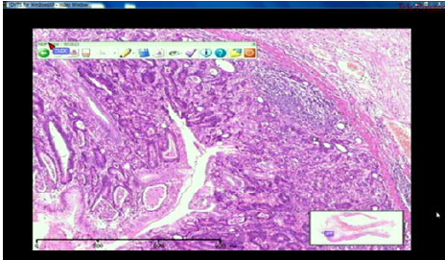
Teleconference beyond the Asia-Pacific region.

Slide 18
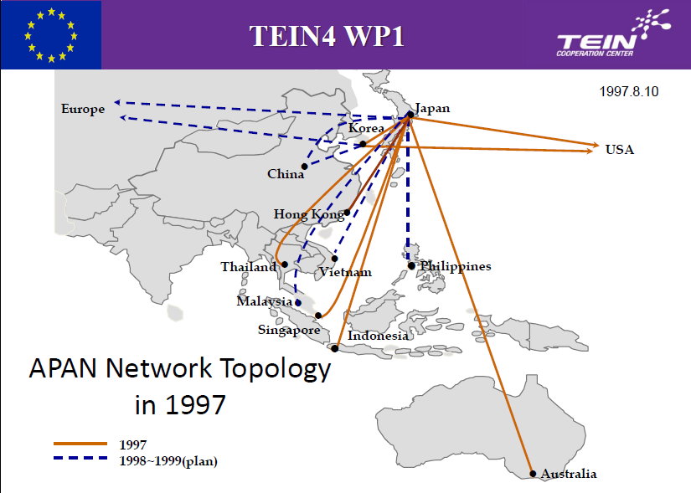

Slide 19
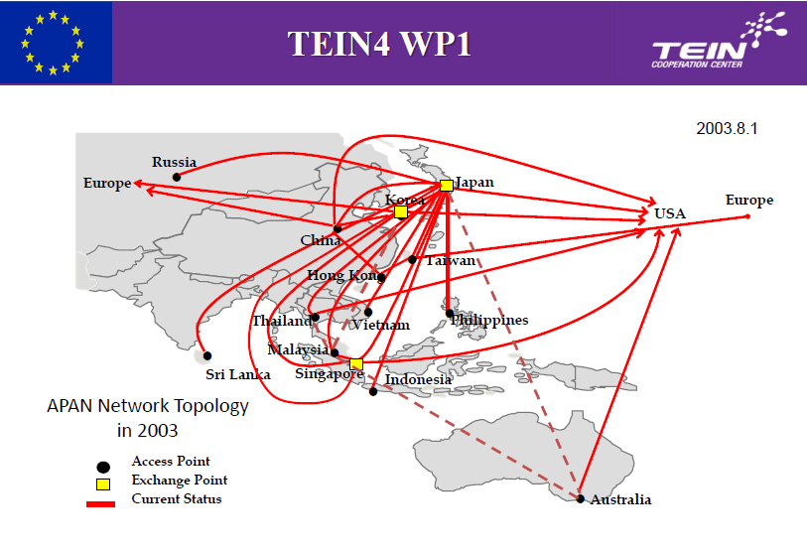

Slide 20
Pioneering telemedicine in action is the Trans-Eurasia Information Network 2 (TEIN2) network. A dedicated research network for the Asia-Pacific region, TEIN2 spans China, Indonesia, Japan, Korea, Malaysia, the Philippines, Singapore, Thailand, Vietnam and Australia and supports a global community of over 30 million users.
Global Telemedicine Project
Project Leader: Prof. Shuji Shimizu, Kyushu University Hospital Goals:
•To develop and expand practical remote medical education systems into Asia and beyond, with high-quality video transmission to educate new procedures and advanced skills in routine basis.
•To keep the system improved constantly with developing technology
•To organize a cooperating team of medical and engineering people
•To promote medical standardization ultimately to provide patients with better healthcare.

Slide 21
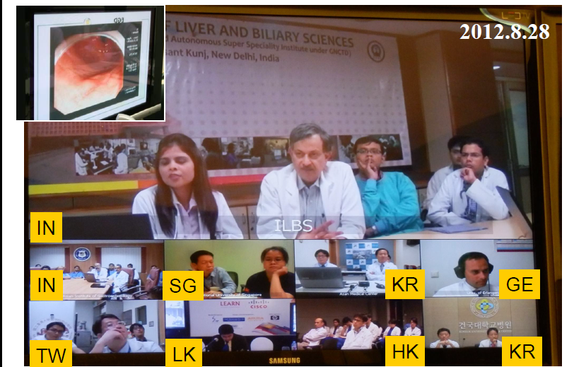
Global endoscopic conference(Vidyo)

Slide 22
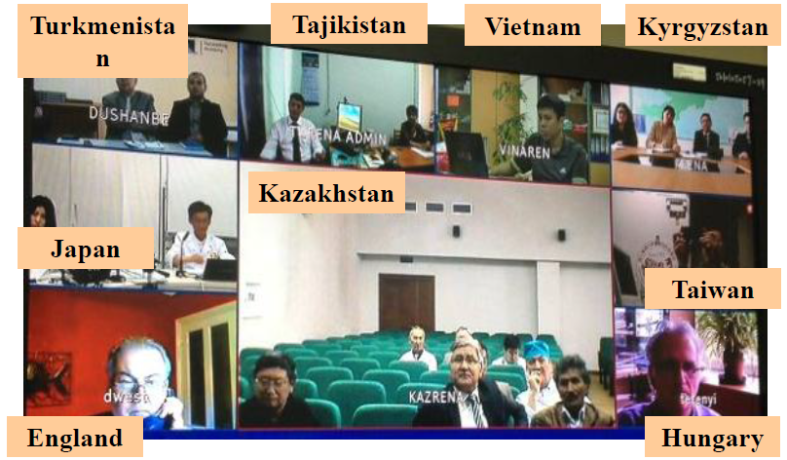
Expansion to Central Asia: CAREN (H.323)

Slide 23
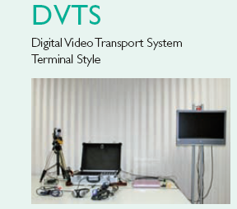
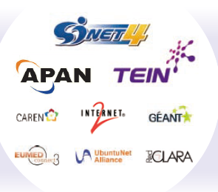

Slide 24
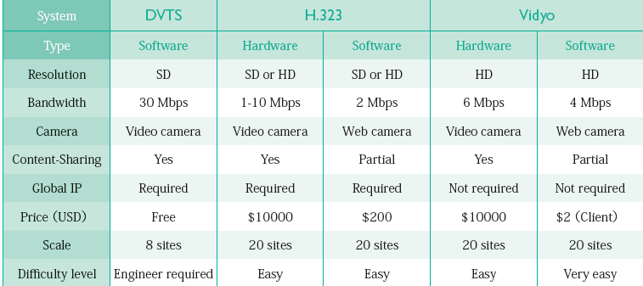

Slide 25
Thank you for Your Attention!

