Slide 1
Kyrgyz State Technical University named after I.Razzakov Telematics Department
The role and importance of logistics information systems in the Asian economy
Akylbek Umetaliev

Slide 2
IN LOGISTICS [from DHL Trend Report, IOT in Logistics]
Almaty, August 2016
This Logistics and Supply Chain Management (LSCM) Certification Program is based on the Modular Learning System on Supply Chain Management (MLS-SCM) of the International Trade Centre (ITC), Geneva, Switzerland.

Slide 3
The robust trade, economic growth, and liberalization policies followed by many Asian countries have resulted in increased trade volumes. The ensuing increase in transportation, handling, and warehousing needs has led to a demand for integrated logistics solutions in the region. Increased globalization in manufacturing and other technological advancements has made companies focus more on core activities, and thus logistics activities have been outsourced as a cost-effective solution.

Slide 4
1. Understanding the Internet of Things
“CONNECTING THE UNCONNECTED”
Internet connections now extend to physical objects that are not computers in the classic sense and, in, fact, serve a multiplicity of other purposes.

Slide 5
Physical Objects that Could be Connected to the Internet
Devices Connected to the Internet

Slide 6
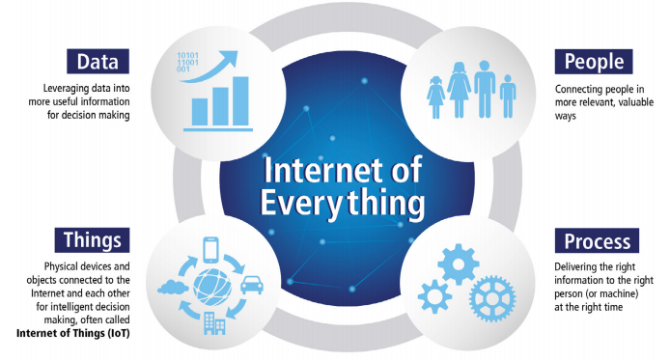

Slide 7
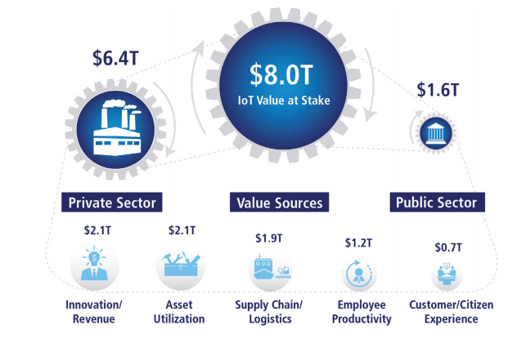
The Internet of Everything vs. IoT
Value at Stake is the net profit created as the result of IoE
IoE consisit of M2M and P2P connections
IoT is a platform for digital disruption and a subset of IoE
Smart Parking

Slide 8
2. IOT BEST PRACTICES IoT Impacts on Logistics
Monitoring
Measuring
Controlling
Automating
Optimizing
Learning

Slide 9
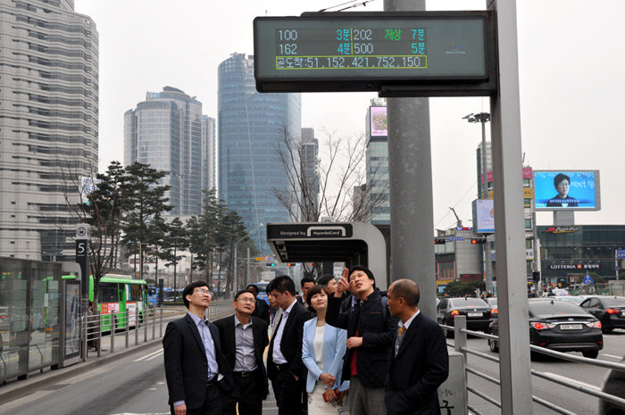
Traffic and Fleet Management
25% of Total Value at Stake from IoT
Seoul City Transportation Information Center (TOPIS)

Slide 10
Port of Hamburg “SmartPORT”
Efficient operations
Economic development
Minimizing traffic
300 roadway sensors manage traffic disruptions
Parking Information

Slide 11
Resource and Energy Monitoring
IoT sensors track all kinds of resources:
Petroleum
Natural gas
Electricity
Water
Collaboration of systems:
SCADA
GIS
GPS
ERP

Slide 12
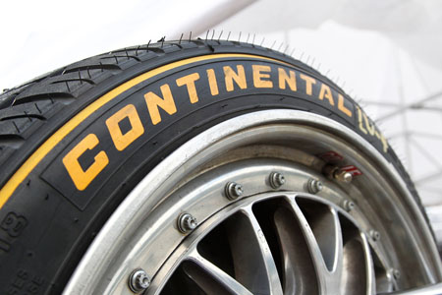
Connected Production Floor
IoT gives an information about
Performance of machines
Ambient conditions
Energy consumption
Status of Inventory
Flow of materials
Continental Tire
use Wi-Fi sensors on carriers, inventory, so that employees can see carrier locations on their mobile devices

Slide 13
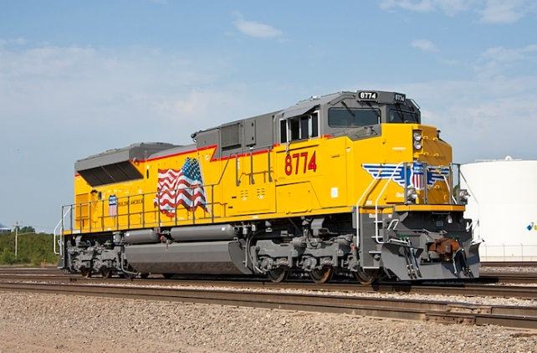
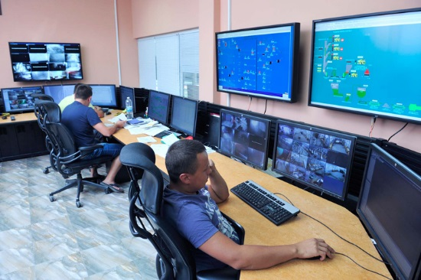
Safety and Security Equipment and Employee Monitoring
Union Pacific
Dundee Precious Metals (DPM)
Acoustic sensors
Visual sensors
Tracking equipment and miner movements with help of IoT

Slide 14
Health Monitoring Physical Security
Mobile Apps
SmartLock

Slide 15
Customer Experience Connected Retail
For retail
In-shelf availability
Inventory
Merchandise Optimization
Planogram Compliance
Loss prevention
Mobile Payments and more
For consumers
Checkouts
In-store guidance
Mobile payments

Slide 16
3. IOT IN LOGISTICS
IoT can
Connect different assets along a supply chain in a meaningful way, and then
Analyze the data generated from these connections to capture new insights.

Slide 17
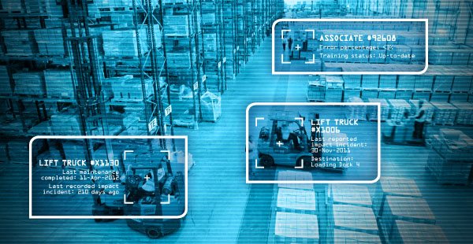
Warehousing Operations
Smart Inventory Management | RFID volume dimension damage detection | Eliminates time-consuming tasks manual counting
Real-time Visibility | Right location temperature humidity | Prevent costly out-of-stock situations misplacing incorrect condition

Slide 18
Accurate Inventory control | Right item in right order for delivery | Eliminates time-consuming tasks, Manual counting
Optimal Asset Utilization | Monitor all assets in real time | Speed, location, productivity, accuracy

Slide 19
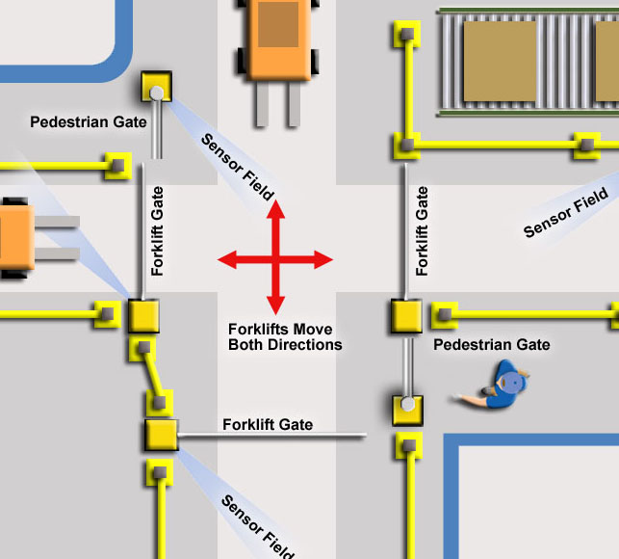
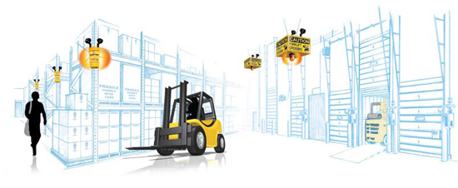
Health and Safety | Sensors and Actuators combined with radar and cameras attached to forklifts | accidents can be avoided by using pressure sensors to detect when a load has become too heavy, uneven load has been placed

Slide 20
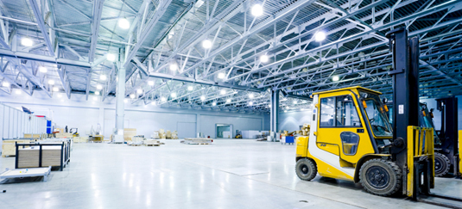
Connected workforce | RFID Movement of people and objects | Monitors health, fatigue of workers, where warehouse workers can improve walkways
Smart Warehouse Energy Management | HVAC and LED Lights, Automatic dimming and lightning systems, heating, ventilation | Saves energy consumption, therefore cuts the costs

Slide 21
Freight Transportation
Cargo Theft Incidents
946 across the US in 2012
689 in Europe
Inventory delays
1. Location and Condition Monitoring
Telematics sensors in trucks and multi-sensor tags transmit data on location, condition, if a package has been opened(theft)

Slide 22
2. Fleet and Asset Management
Monitor how often a truck container, other equipment are in use or idle
Spare capacity
Suggestions for consolidation and optimization of route
Fleet efficiency
Fuel economy
Reduce deadhead miles

Slide 23
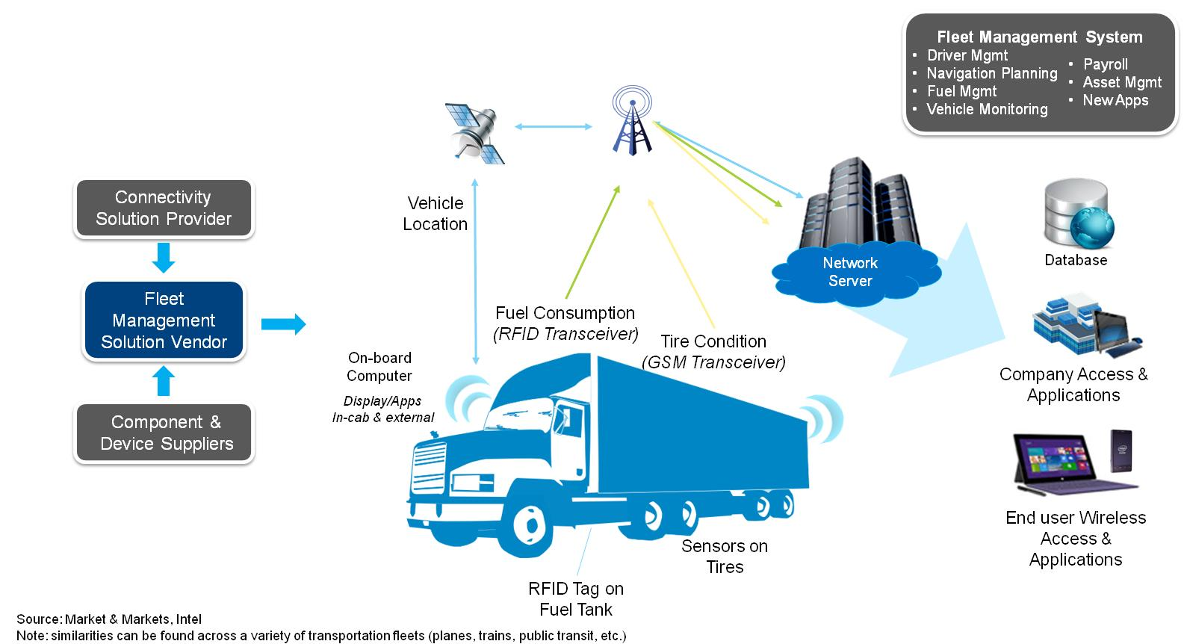
IOT: Fleet Management Solution (1)

Slide 24
IOT: Fleet Management Solution (2)
Real-Time Fleet Management with Vnomics
Promoting Green Logistics

Slide 25
3. Predictive Asset Lifecycle management
Predicts assets failures, accidents, damages, material degradations
Automatically schedules maintenance
MoDe (Maintenance on Demand)

Slide 26
4. Health and Safety
Prevents collisions
Monitor driver fatigue
Alert them by vibrations and audio alarms
Detect pupil size, blink frequency

Slide 27
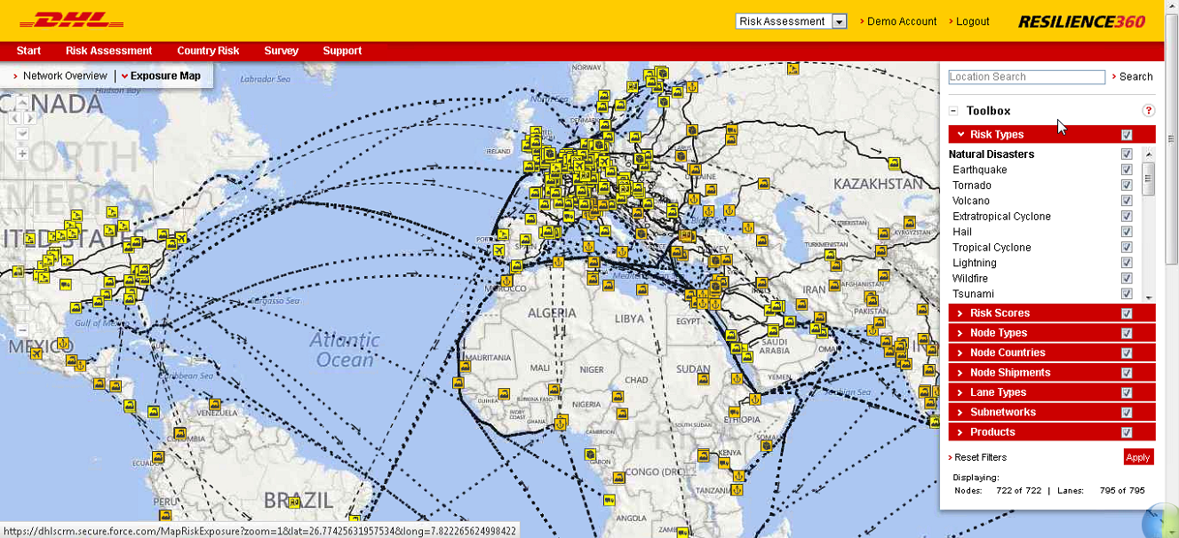
5. End-to-End Supply Chain Risk Management
Natural Disasters
Sociopolitical Unrest
Conflict
Economic Uncertainty
Market Volatility
Catastrophes
DHL Resilience360

Slide 28
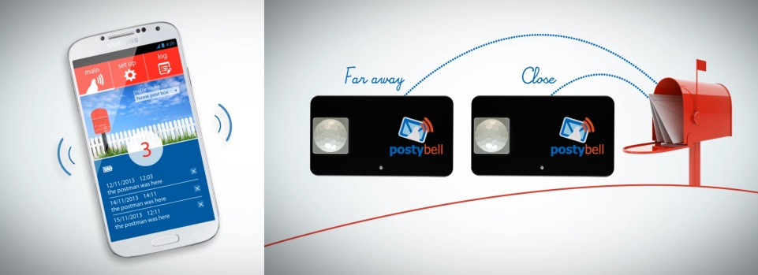
Last-Mile Delivery
Optimized Collection from Mail Boxes
Postybell
DHL Paketkasten
In the future=>
temperature-controlled smart lockers, delivery of parcels, groceries, other sensitive goods.

Slide 29
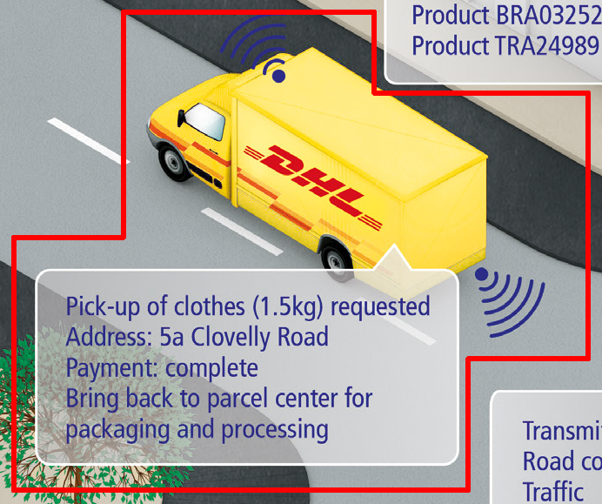
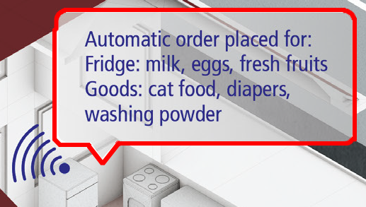
Automatic Replenishment and Anticipatory Shipping
Detects low stock retailers
Orders automatically
Predicts purchases

Slide 30
Flexible Delivery Address
If a delivery is planned during the day, a customer could change the address to that of a neighbor who is home or at a workplace

Slide 31
Monetize and Optimize the Return Trip
Customers just take a photo of a product
Shyp => collects the information about the product, buys, packages and delivers it

Slide 32
Next Generation Visibility
Customers can check the information about temperature of a product during transportation;
Know if it is a fragile;
Greater product transparency and service standards
Smart Label

Slide 33
SUCCESS FACTORS for IOT in LOGISTICS
Logistics is a typically low-margin and fragmented industry
Successful IOT in Logistics require strong collaboration between different players

Slide 34
To achieve this, there will be some key success factors required:
Clear and standardized approach for the use of unique identifiers or ‘tags’ for various types of assets among different industries on a global scale
Seamless interoperability for exchanging sensor information in heterogeneous environments
Establishment of trust and ownership of data and overcoming privacy issues in the IOT-powered supply chain
Clear focus on reference architecture for the IOT
Change in business mindset to embrace the full potential of the Internet of Things

Slide 35
OUTLOOK
IoT presents opportunities for automation, its impact on logistics
Connects the unconnected
Enhances safety & security , privacy and control of personal information
Things connected are 15 billion today to 50 billion by 2020
50 billion is only 3 % of all things

