Slide 1
Kyrgyz State Technical University named after I.Razzakov Telematics Department
Telemedicine wireless communication in Kyrgyzstan
Rahat Eshimbekova

Slide 2
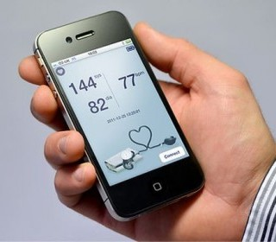
According to the World Health Organization, the world has up to 7 billion mobile phone users. Mobile networks cover more than 85% of the world population. This global coverage of cellular communication, along with the ever-increasing technical capabilities of mobile phones contributes to the emergence of this new direction in public health, as a mobile health (mHealth), associated with the use of mobile phones for a healthy lifestyle, the prevention and treatment of diseases.

Slide 3
Mobile health - a term denoting the use of mobile devices and wireless technologies to medical care, as well as providing a healthy way of life. The most familiar example for many mHealth technology is software for mobile phones and tablets connected to the control of physical condition (eg, weight) or fitness.

Slide 4
MHealth simplifies and accelerates the diagnosis of diseases, communication with doctors, the exchange of relevant information, diagnosis, receive recommendations on treatment and will reduce health care costs. And this is especially important, because on the agenda in many countries is the rising cost of health care because of the aging population and the increasing prevalence of chronic diseases.
So who thought of using mobile technology to provide each and every access to health care? The initiative comes from the World Health Organization (WHO) and is based on the simple and obvious truth: today about 90% of the world's population have access to a telephone. The majority of them live in low- and middle-income countries where the problem of access to qualified treatment often is quite acute.

Slide 5
The system will be incorporated the use of mobile phones, personal digital assistants (PDAs), smartphones, tablets and other similar devices. Wireless technologies, which will ensure the system include:
voice communication;
SMS;
Bluetooth;
GPRS, i.e. System General Packet Radio Service;
3G and 4G, i.e. the communication system of the 3rd and 4th generations;
GPS, i.e. global navigation satellite system.

Slide 6
But what exactly can offer mobile healthcare for us? Its potential is enormous, but most of it is about the four possible areas of application, namely:
mobile telemedicine;
referral services;
emergency telephone services;
mitigation of disasters and emergencies.
In addition, information technology can be used to:
reminders to the doctor;
a reminder of the mode of treatment and taking drugs;
monitoring of the patients as well as medical examination and data collection (surveillance);
raise public awareness about the issues of health and access to information in general;
social mobilization to promote health and more.

Slide 7
Mobile health in the world
Pilot projects in the field of public health carried out around the world. As a rule, their goal is to use new technologies, in search of "smart" solutions and trying to minimize costs.
For example, in the UK no-show patients on outpatient care (which they simply forget) annually costs the government 790 million pounds. To think that this money can be saved if only to remind forgetful citizens that they should see a doctor!

Slide 8
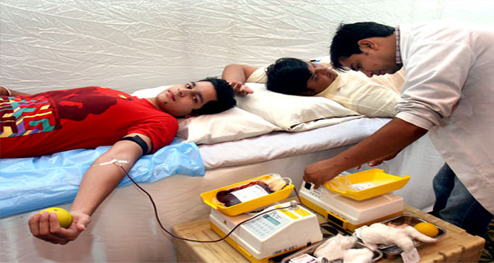
In India, information technology is used in the "Blood Donor". Specially designed computer application allows you to find a donor with the right blood group in the nearest town or district. The system can post questions and information about blood donations, which have often save lives.

Slide 9
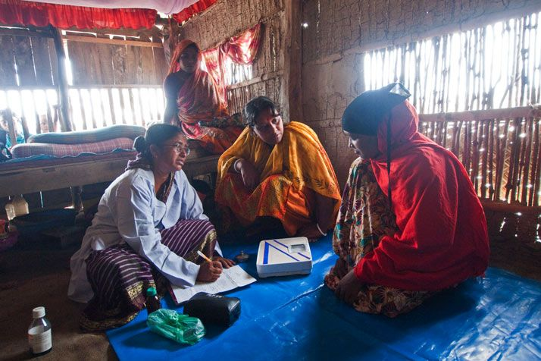
«Medic Mobile» - a project that has been tested in Malawi and will soon be launched in Sri Lanka and Bangladesh. He solved the problem of access to health care in rural areas, where one doctor has to dozens of patients scattered for miles around. To get from one settlement to another, the medical staff has to involve a lot of time that can be saved with the help of mobile phones and a special computer program that organizes and analyzes data sent by SMS. Wireless technology will also reduce fuel costs and human resources, and the effectiveness of the health centers has increased significantly.

Slide 10
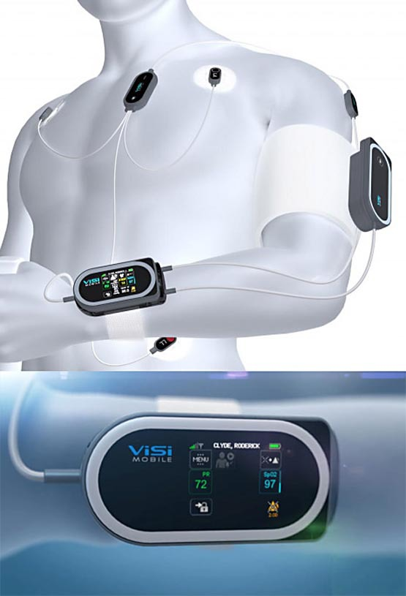
The prospect of mobile health
The possibilities that are now available in a mobile medicine are growing rapidly with the emergence of new devices, sensor applications. Telemedicine and remote monitoring, data of patients, e-cards, electronic prescriptions, control sleep and pregnancy, etc. This industry is growing rapidly worldwide, even in underdeveloped countries, where it can become a "magic wand" for people who do not have access to medical care.

Slide 11
The development and implementation of mobile technology for the sphere of healthy lifestyle and medicine around the world is uneven. According to the GSM Association, the United States and China are the biggest markets in the area of mobile health and by 2017 will share the more than one third of the world market. It is here that appears the most of new technologies and ideas, which in the future should be the basis for new devices and services. The report Brookings Institution, argues that in 2017 the income of mHealth in the US will reach 5.9 billion USD, while in China - about 2.5 billion USD.

Slide 12
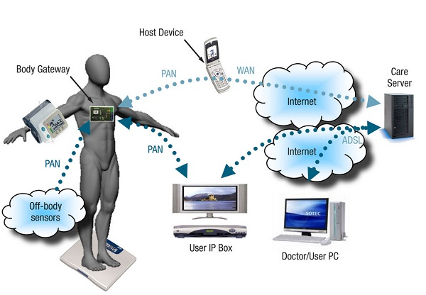
Areas of mHealth
MHealth has great prospects in public health and medicine and can be used as a tool for remote diagnosis and treatment of diseases, population and disease prevention work with vulnerable groups. The ubiquity the mobile offers the possibility of establishing two-way communication with any person at any time, including the transfer of health-related data.

Slide 13
The economic benefits of mobile health care over traditional methods allow, firstly, significantly optimize the cost of medical and preventive measures, while maintaining the quality and efficiency of health-measures.
Second, mobile health due to easy scalability will increase the coverage and efficiency of epidemiological surveillance of the prevalence of disease, as well as provide new opportunities in solving the problems of availability of qualified medical assistance and quality control of medical services.
Third, the mobile health care can have a significant positive impact on clinical practice. Already, a number of problems in the organization of the treatment process is achieved with the help of mobile phones, from eliminating the need for paper work for the doctor and ending the use of automated systems to provide two-way communication with the patient and to track biometric indicators, identify side effects, monitor compliance prescribed treatment, and also send subscribers the necessary health-related information.

Slide 14
Status of telemedicine in Kyrgyzstan
In many health care organizations have already appeared X-ray machines, electrocardiographs, combined with a computer and having the ability to immediately transmit the results via Internet. Some free advice by experts of republican, municipal healthcare organizations are held periodically. For example, in 2014 we held several remote consultations complex patients with allergic diseases in the department of family medicine Kyrgyz State Institute of retraining and advanced training. The National Center for maternal and child health at the Department of Surgery № 1 a number of remote consultations surgical patients, and so on. The receiving program is also to introduce remote consultations, but no published reports of positive.

Slide 15
When remote consultations have been a number of problems:
1. The doctors in the field are not sent the documents of patients;
2. Consultants-doctors are not interested in remote consultation;
3. Doctors and patients are not mentally prepared for remote consultations and insufficiently informed about the possibilities of information and computer technologies.

Slide 16
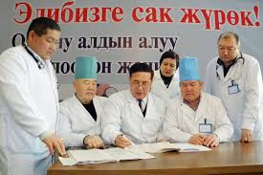
For Kyrgyzstan at this stage it would be a suitable algorithm for remote consultation, which would be legally responsible physician prescribing destination and assistance of consultants would be of a recommendatory nature.
Lack of legal documents regulating the legal responsibility and sources of funding hinders the development of the introduction of telemedicine in Kyrgyzstan.

Slide 17
Thank you for Your Attention!

