Slide 1
Kyrgyz State Technical University named after I.Razzakov Telematics Department
Socio-economic aspects of development of mobile technologies in Asia
Rahat Eshimbekova

Slide 2
For more than 10 years, Asia - the champion on the use of mobile phones. In China lives the maximum number of mobile Internet users: 557 million people (about 86% of the population having access to the Internet). South Korea regularly beats the world record for speed broadband data over cellular networks. Japanese operator NTT DoCoMo introduced the first technology i-mode mobile internet.
There is no doubt that it is the Asian countries have become trendsetters in the field of mobile technology.

Slide 3
The public transport of any large city you will definitely see people who watch online video from your mobile device. However, in Asia, went even further: for example, Singaporeans are using a smartphone, even in your own living room - instead of watching TV or PC. For 56% of the population smartphone is the main device screen before they spend their free time at home.

Slide 4
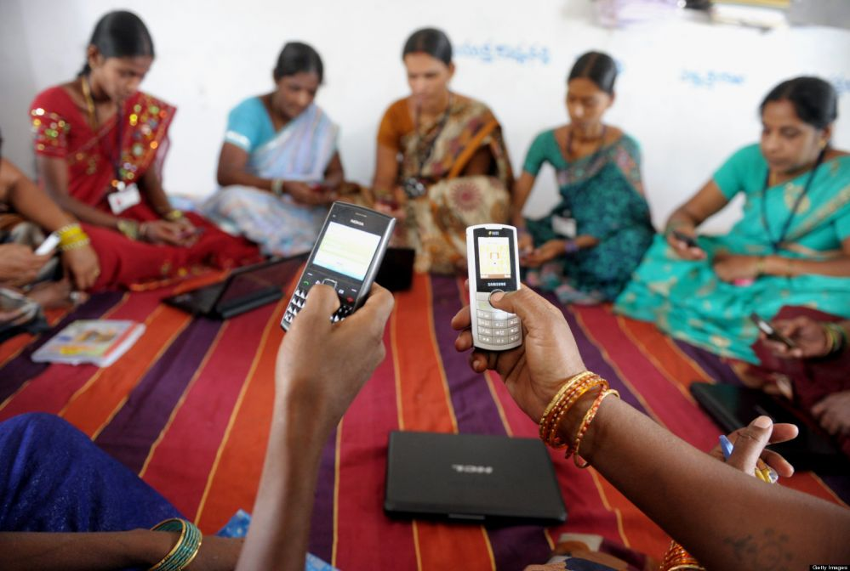
Another study found that more than 67% of end users in India, Southeast Asia and the Middle East was chosen mobile device for watching movies, music videos and television programs. Only 20% of men and 29% women turn on for this TV.

Slide 5
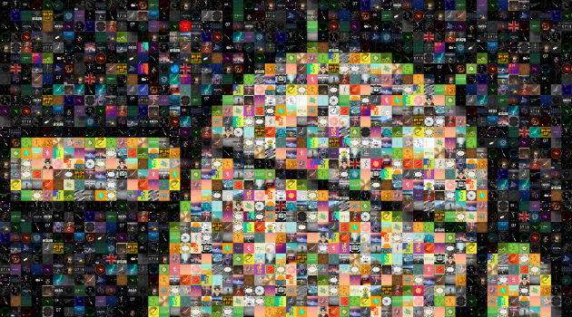
In some Asian countries, the share of smartphones in the market is nearing the peak value: for Hong Kong and Singapore the figure is 87%, in Malaysia - 80%, in Australia - 75%. Using handheld devices, Singaporeans are watching movies, YouTube videos and TV shows online not only at home.

Slide 6
With mobile devices Asians solve many different problems, and more often than representatives of other countries. In this region, e-commerce is booming: 89% of Japanese and 66% of South Korean consumers buy goods using a means of mobile commerce (m-commerce). For comparison, in the USA, the figure is 10% in the UK - 7%. See the difference?

Slide 7
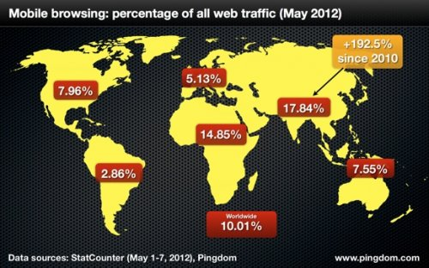
In Asian countries, people go online primarily from mobile devices, for example, so do 88% of South Koreans. And 41% of the population of Singapore is building a travel routes on portable devices. Asia-Pacific leads the world and the number of mobile applications. This is another proof that the people of these countries prefer mobile technology.

Slide 8
And what is the situation in Kyrgyzstan?
According to the World Bank and InfoDev, Kyrgyzstan mobile communication covers 96% of the population, and according to Internet World Stats, Kyrgyzstan leads in Central Asia in terms of Internet penetration to 39.3% -s. These data indicate that today Kyrgyzstan is not only trying to keep up with the rest of the world in the development of modern ICT, but even tends to take a leading position.

Slide 9
It is wonder what is the level of penetration of mobile communication in Kyrgyzstan?
On specified in the poll in all regions of Kyrgyzstan, the question: "Do you have a cell phone?" The following answers were:
Bishkek and Chui region - 98.5%;
Talas region - 100%;
Jalal Abad region - 99%;
Osh region - 98.1%;
Issyk-Kul region - 97.5%;
Naryn region - 95%;
Batken region - 85%.
In general, it can be concluded that almost every active citizen of Kyrgyzstan today
has its own mobile phone.

Slide 10
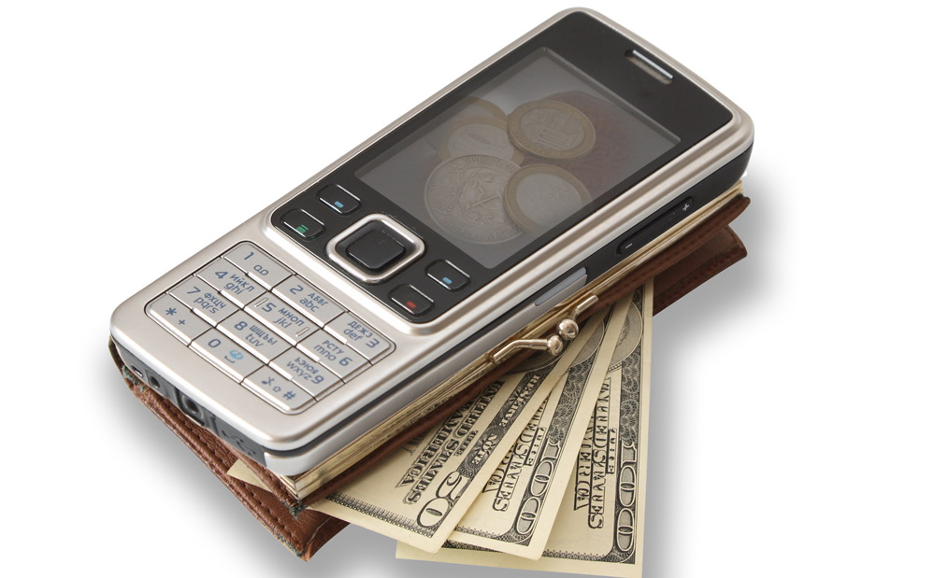
On a question: "How much money did you pay for mobile communications," were received the following answers:
basis to only $ 10,
less than a third - to $ 20,
every seventh - over $ 20, and
every twentieth only about $ 2

Slide 11
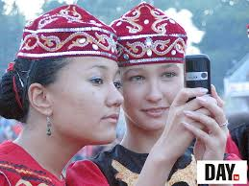
For what Kyrgyz citizens using mobile phones and how often?
More than 95% - are using a mobile phone to talk
more often than half - using mobile Internet (more than a third - quite often);
Nearly half of mobile phone users also have fun on it - probably young.

Slide 12
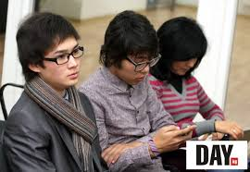
Age of mobile Internet users
18-22 years - 10%;
23-35 years - 33%;
36-45 years - 40%;
More than 45 years - 17%.
Conclusion: about three-quarters (73%) of all subscribers using mobile Internet are between 23 and 45 years, i.e. in the active working age, and only 10% customers are students.

Slide 13
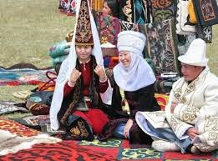
Reasons for not using the Internet
45,61% of citizen - do not know how to use it;
39,53% of citizen believe that they do not need the Internet (yet);
For 11.49% of the citizen - Internet services are too expensive; and
3,38% of citizen do not use the Internet because of language barriers.

Slide 14
Where Kyrgyz citizens often use the Internet?
use the Internet at work - 23%;
The internet cafe - 16%;
Through own cell phone - 35%
go online from home - 26%;
Conclusion: Only about a quarter of Internet users have access to the network Internet from their home computers, the other a quarter of Internet users have access to the Internet, mainly at work. Some 16%, i.e. one in six has no Internet access either at home or at work, and goes to an Internet cafe, probably students. AND more than one third of Internet users surf the Internet mainly from their Mobile phones are likely to pupils and students.

Slide 15
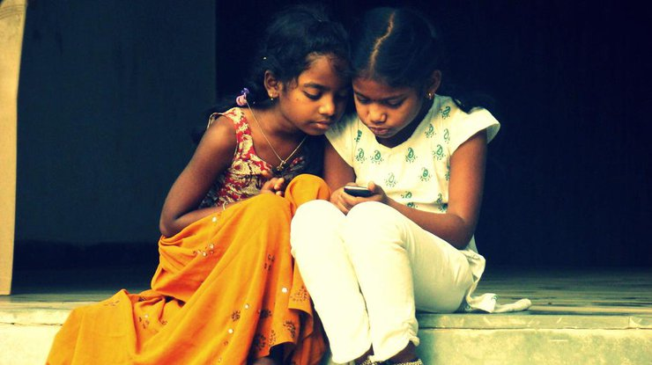
From all the above, we can conclude: In Asia, the mobile device - not just basic, but sometimes is a single computer. This fact is explained by the fact that local residents earn less than Europeans or Americans. If Western Internet users went to the smartphone from the desktop and laptop, in Asia, many users have never even thought about to buy a PC.

Slide 16
Thank you for Your Attention!

