Slide 1
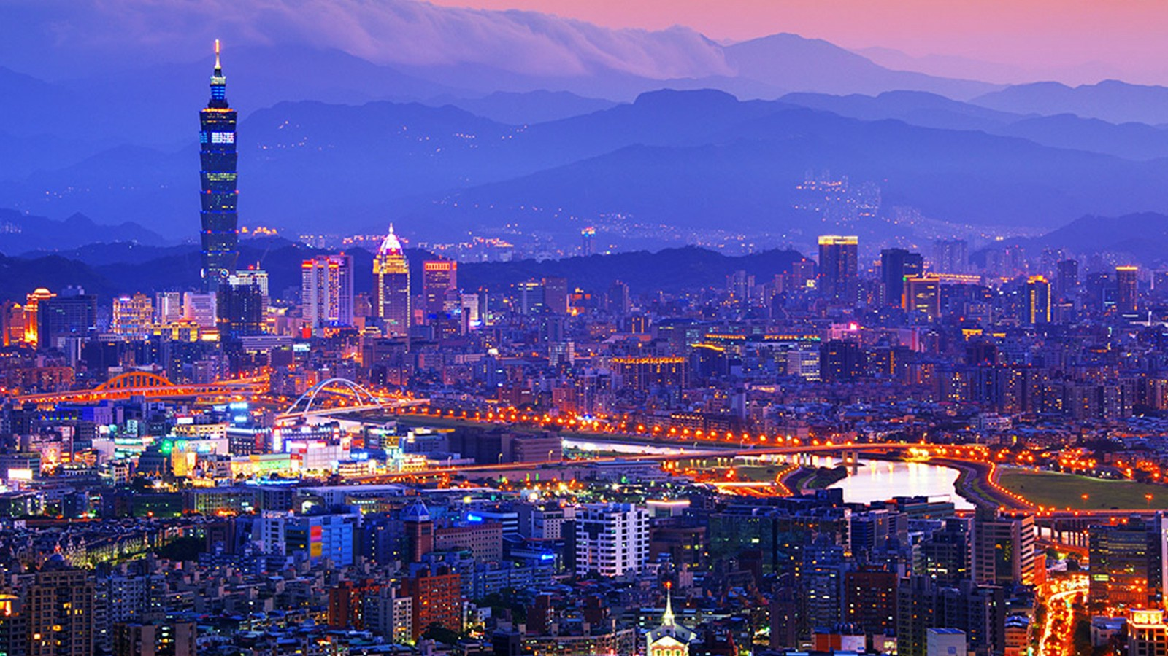
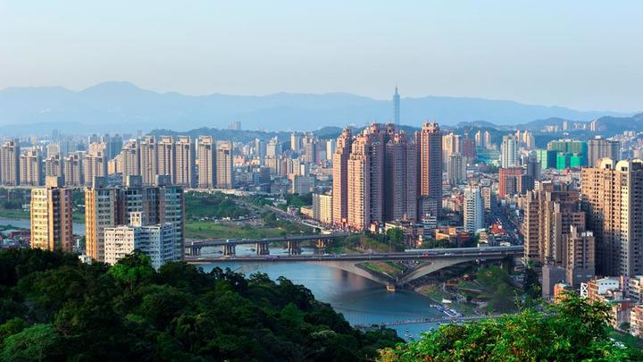
The capital of Taiwan

Slide 2
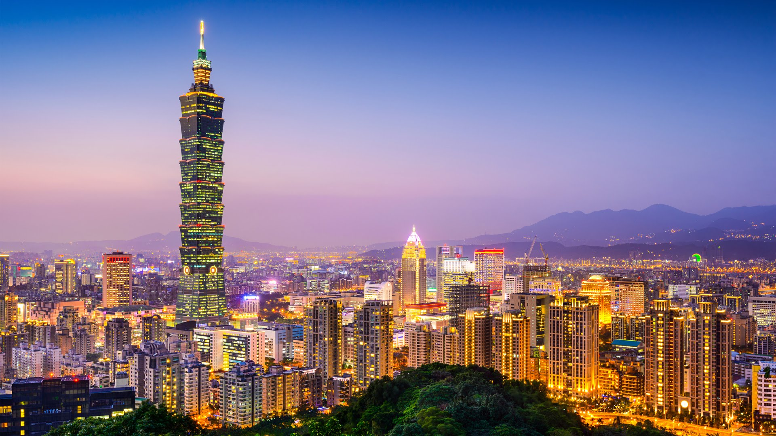
Taipei

Slide 3
Taipei is the capital of Taiwan province, its main transportation hub and financial center. Located in the Northern part of the island on the banks of the Danshuihe river and covers an area of about 272 sq.km. It is one of the youngest and most densely populated cities in the world, rapidly developing and strengthening its position in the region. Its territory is home to about 3 million people, most of whom are Chinese and Taiwanese.

Slide 4
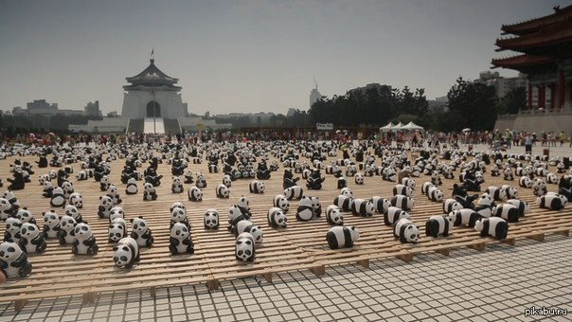
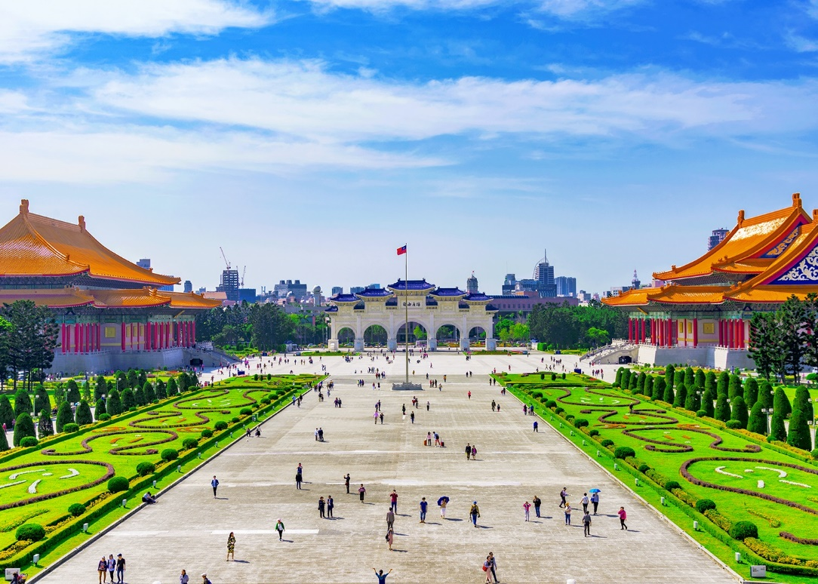
Place

Slide 5
One of the main attractions of Taipei can be considered the Chiang Kai — shek memorial-an architectural complex in the traditional Chinese style in memory of the Generalissimo and the former President of the Republic of China. In front of The Chiang Kai-shek memorial are the national theatre and the national concert hall, which are located respectively at the southern and Northern ends of Freedom square. The entire area is in view of the Presidential Palace. Another famous monument of the capital of Taiwan — sun Yat-sen memorial, which serves as a cultural, social and educational center. It is also worth noting the Museum of the Imperial Palace, which contains a rich collection of paintings, calligraphy, sculpture, jade and porcelain, etc.

Slide 6
Taipei Museum of fine arts was opened in 1983 and is a building in the style of Japanese metabolism. Here are mainly works by contemporary Taiwanese artists, made after 1940. In 2001, the Museum of modern art was also opened in the old building of the city government. The national Museum of Taiwan — the oldest on the island, was founded in 1908 by the colonial government during the administration of the country by the Japanese.

Slide 7
A well-known attribute of the city is also a skyscraper Taipei 101 height of 509.2 m (with a spire). It is the third tallest building in the world after the Burj Khalifa (828 m) in Dubai and the Abraj al Bayt (601 m) in Mecca.

Slide 8
Taipei zoo — the largest and oldest on the island, was established in 1914, during the stay of the island under the control of Japan. The zoo is located on the Northern tip of the city, in the area of Yanshan mountain; among many other animals you can see a large Panda, Koala and penguins.

Slide 9
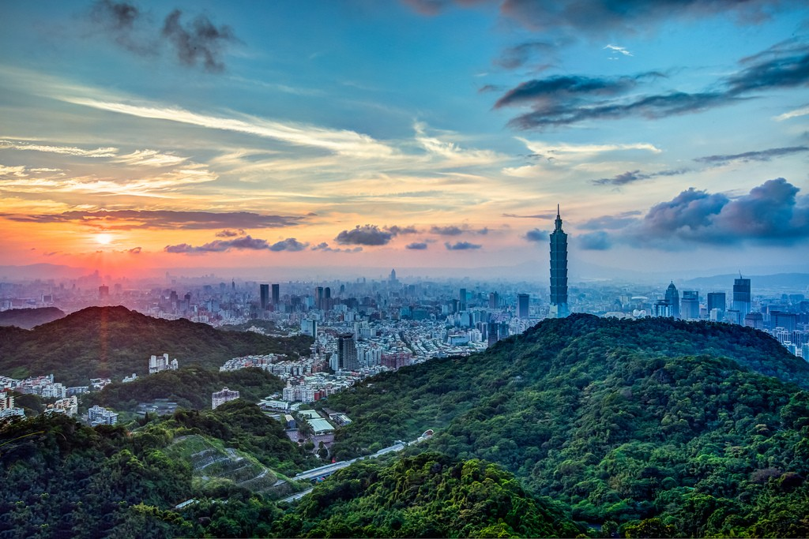
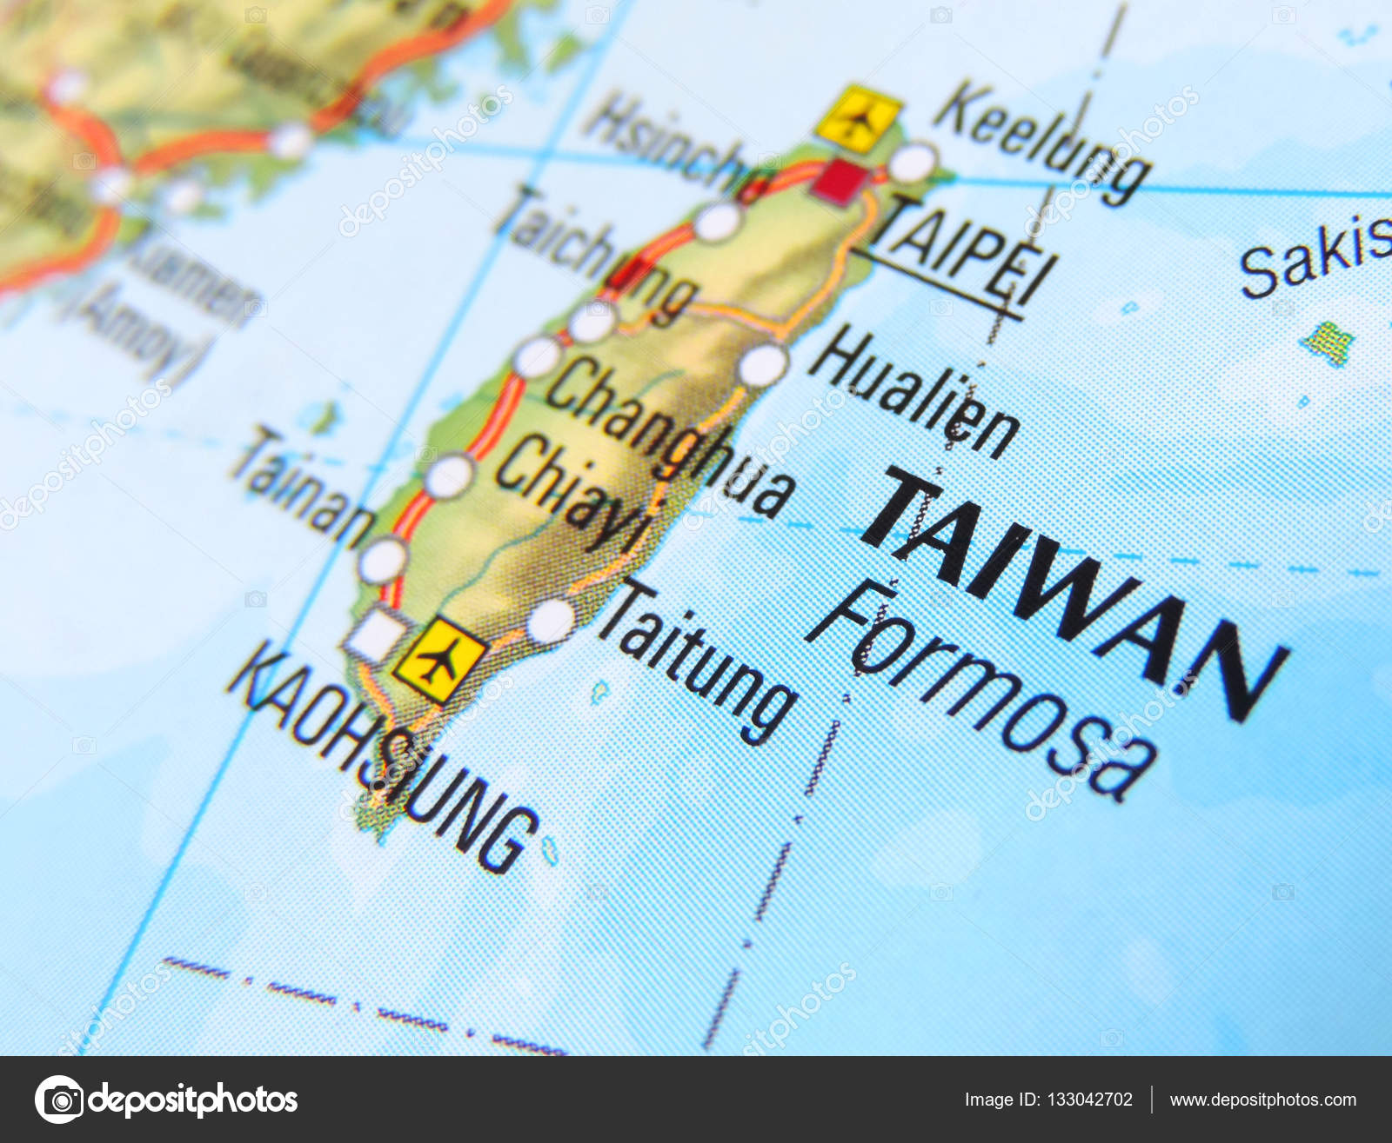
Geography and climate

Slide 10
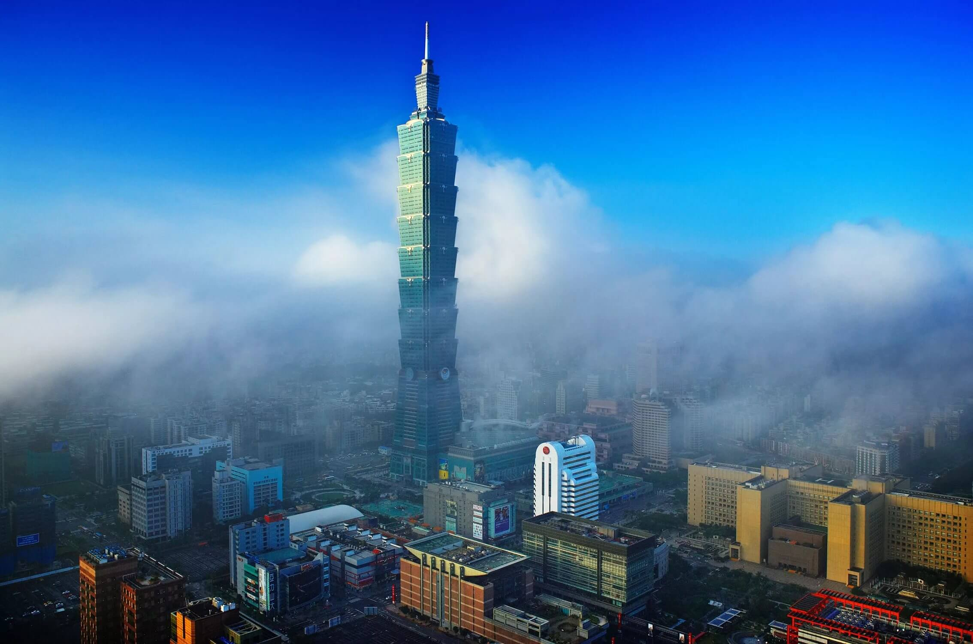
The climate of the city is characterized as tropical monsoon with hot humid summers and short mild winters with frequent fogs. The annual rainfall is about 2,405 mm, most of which falls between may and September.

Slide 11
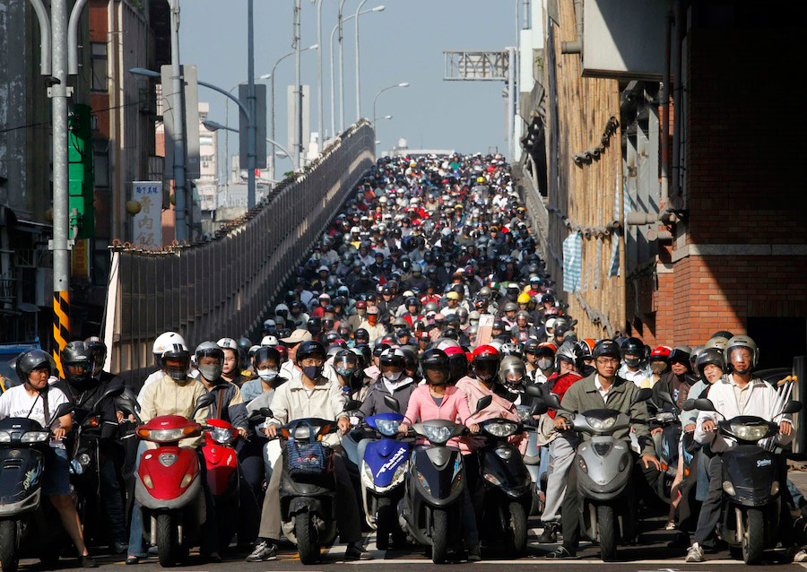
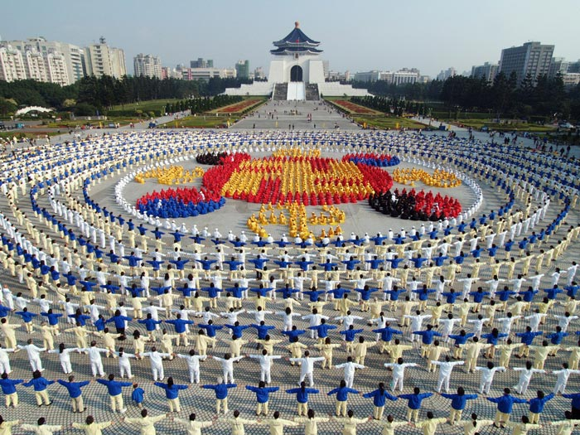
The population is 2 704 810

Slide 12
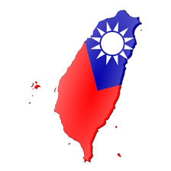
Administrative region
■ Datong
■ Zhongshan
■ Songshan
■ Daan
■ Wanhua
■ Xinyi
■ Shilin
■ Beitou
■ Neihu
■ Nangang
■ Wengshan

Slide 13
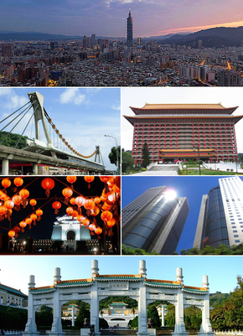
Economy
Taipei is an important industrial center. Important industries are the production of electronics and components, precision instruments, equipment, textiles and clothing, food, etc. Trade, transport and the banking sector are becoming increasingly important in the economy. Tourism is a small but, nevertheless, also quite important component of the city's economy.

Slide 14
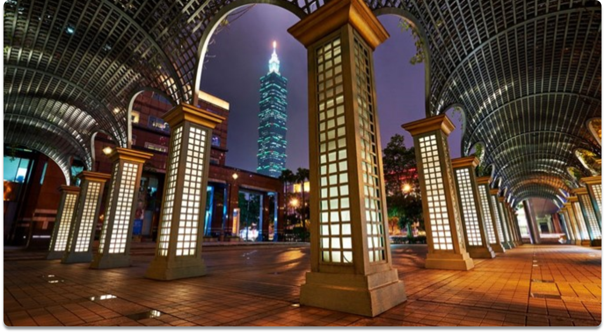
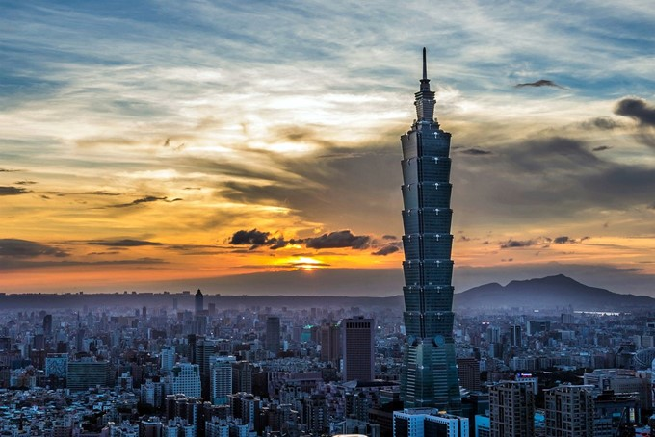
The Taipei City

Slide 15
Thank you very much!!!

