Slide 1
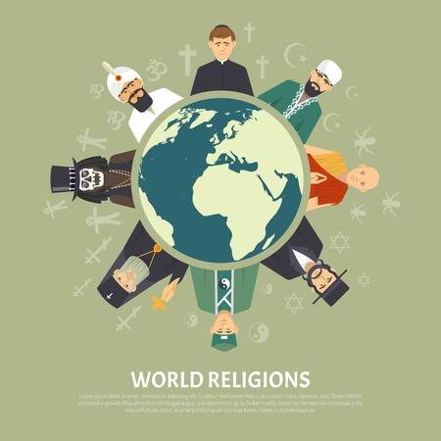
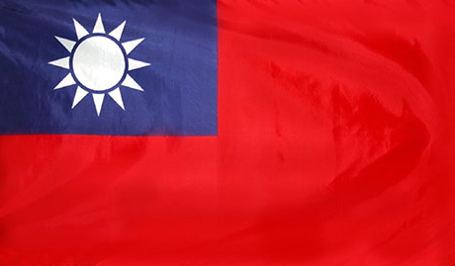
Religions in Taiwan

Slide 2
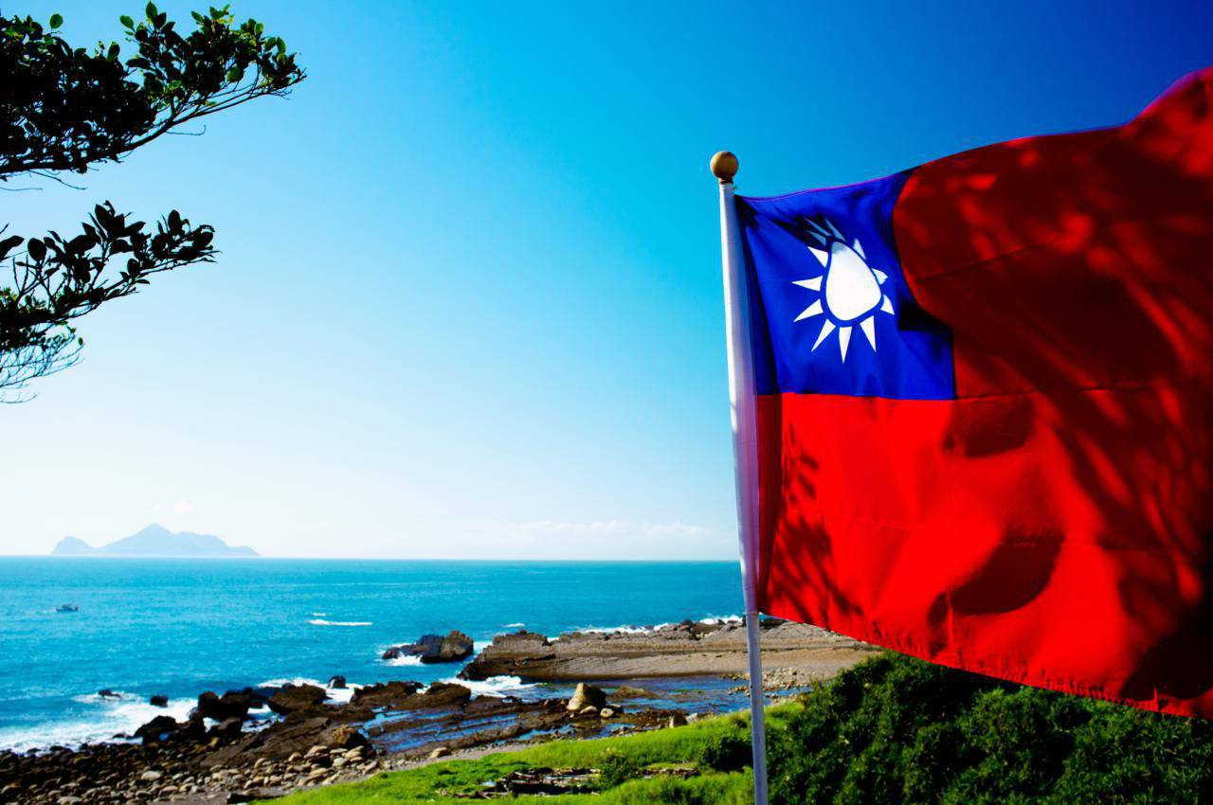
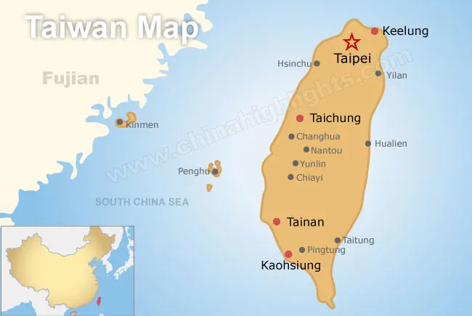
Taiwan
Area - 36,2 km².
Population - 23,6 million people.
Capital - Taipei.
Government - Unitary semi-presidential constitutional republic.
GDP - 1.250 trillion (22 place at world).

Slide 3
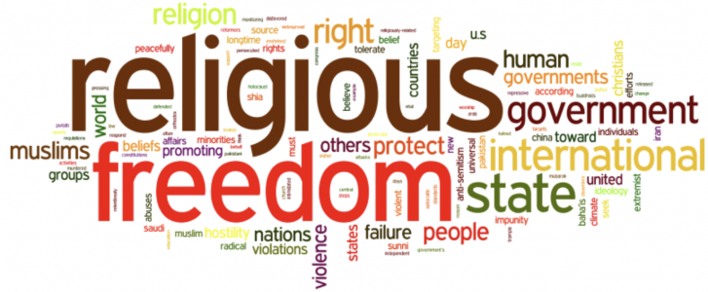
Freedom of religion in Taiwan
The Constitution of Taiwan protects people's freedom of religion and the practices of belief. There are approximately 18,718,600 religious followers in Taiwan (81.3% of total population) and 18,7% are non-religious.

Slide 4
Religions Statistics

Slide 5
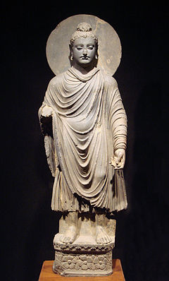
Buddhism
Buddhism is one of the major religions of Taiwan. Buddhism was established in India by Siddhartha Gautama Buddha around 500 BC.
In China Buddhism appeared around 2,200 years ago.
The faith was carried to Taiwan around 400 years ago by the earliest waves of Han Chinese settlers.

Slide 6
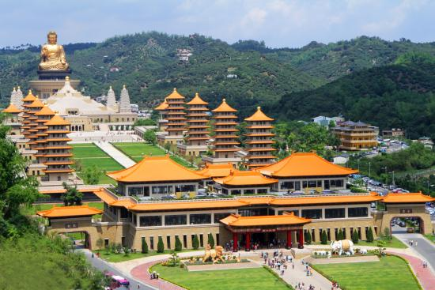
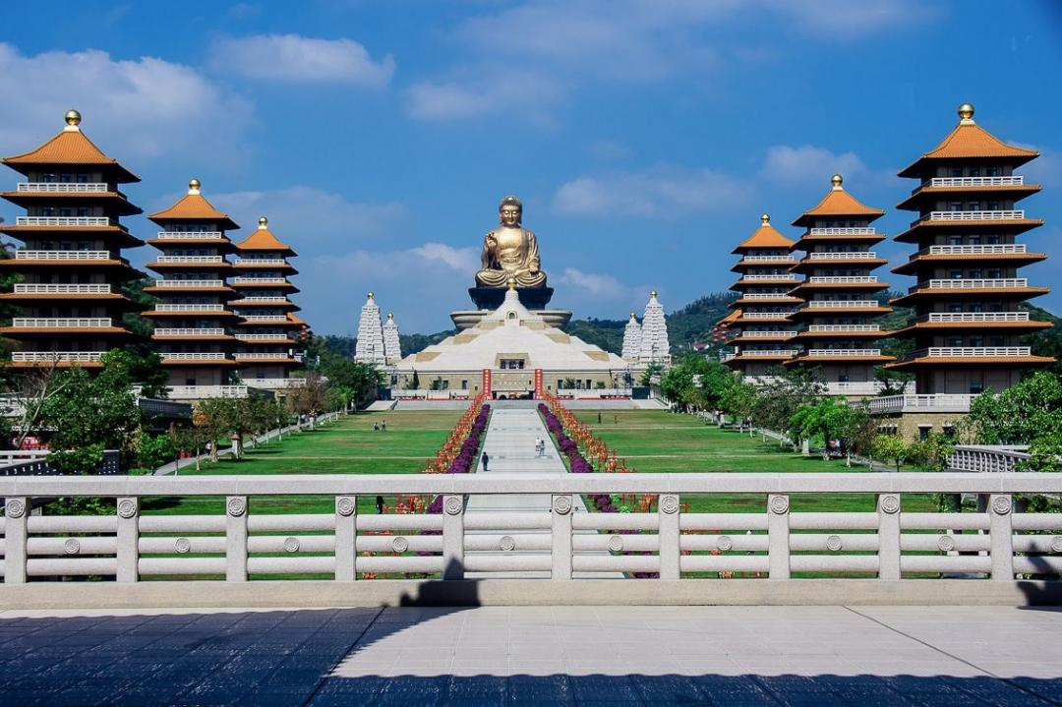
Fo Guang Shan
Fo Guang Shan is an international Buddhist monastic Order based in Taiwan that practices humanistic buddhism. The headquarters of Fo Guang Shan, located in Dashu District, Kaohsiung, is the largest Buddhist monastery in Taiwan.

Slide 7
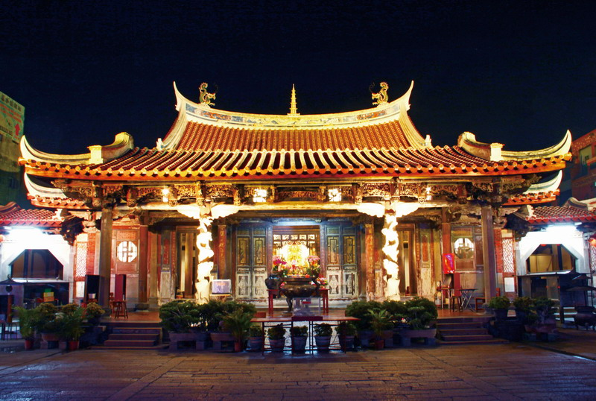
Longshan in Lukang
In Taiwan, there are in total five temples named Longshan, including that one in Lukang. Lukang Longshan Temple is the largest temple in Lukang, whose founding year is unavailable, but most of the structures were completed by 1831.

Slide 8
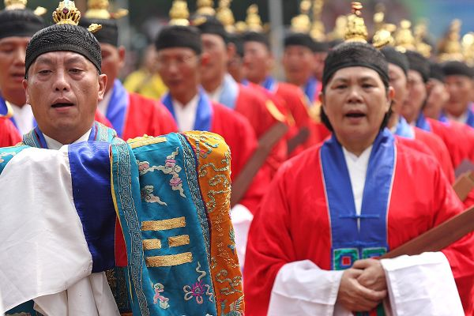
Taoism(Daoism) in Taiwan
Unlike Buddhism, Taoism is a homegrown Chinese and Taiwanese religion and philosophy. Taoism in Taiwan is almost entirely entwined with folk religion, as it is mostly of the Zhengyi school in which priests function as ritual ministers of local communities' cults.

Slide 9
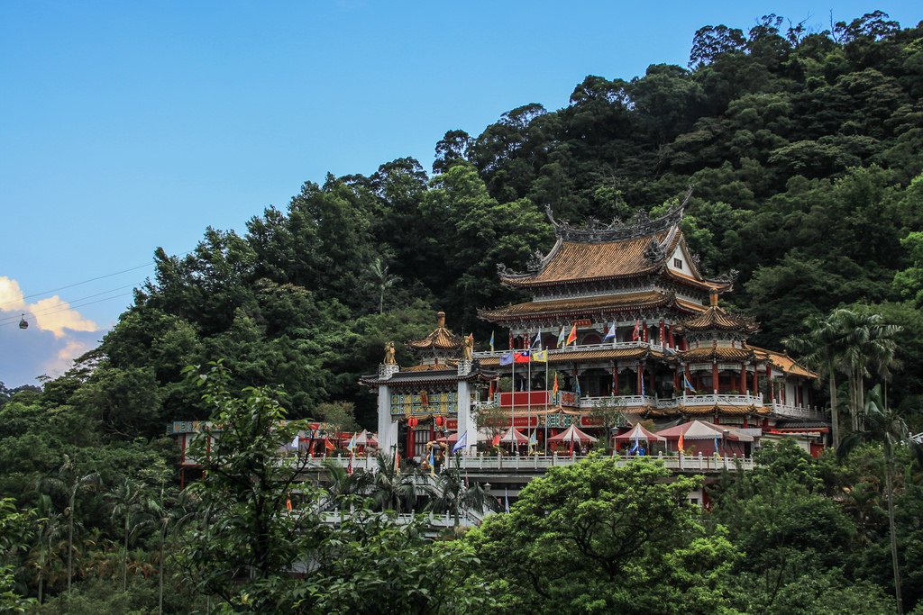
Chi Nan Temple
Zhinan Temple is a Taoist temple on the slopes of Houshanin Muzha, a suburb of Taipei, Taiwan. It was founded in 1882. The temple's main deity is Lü Dongbin, one of the Eight Immortals.

Slide 10
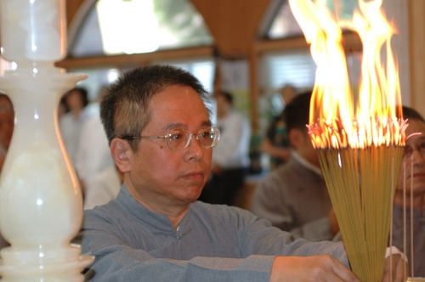
Yiguandao (Ikuantao)
One of Taiwan’s most intriguing faiths (and, by official statistics, the island’s third-largest religion) is I-Kuan Tao. Founded on the Chinese mainland in the 1930s – where it has been banned by the Communist authorities – it claims to reconcile Buddhism, Taoism and Confucianism.

Slide 11
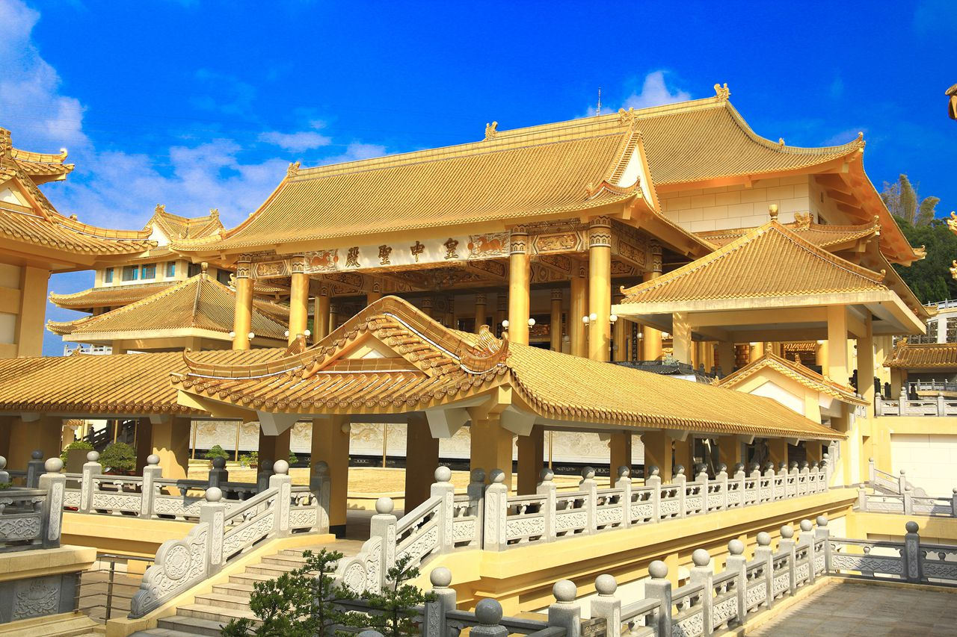
Shenwei Tiantai Mountain Monastery
It is also the largest I-Kuan Tao monastery complex in Asia. The buildings that make up the complex are primarily gold and white in color, and were built in the style of a traditional Chinese The entire complex has a classical yet modern appearance, making it one of Taiwan’s most spectacular religious centers

Slide 12
Christianity in Taiwan
Christians played a leading role in the 20th-century history of China and Taiwan. Both Sun Yat-sen and Chiang Kai-shek became Christians in early adulthood, as did Lee Teng-hui, Taiwan’s first native-born president.

Slide 13
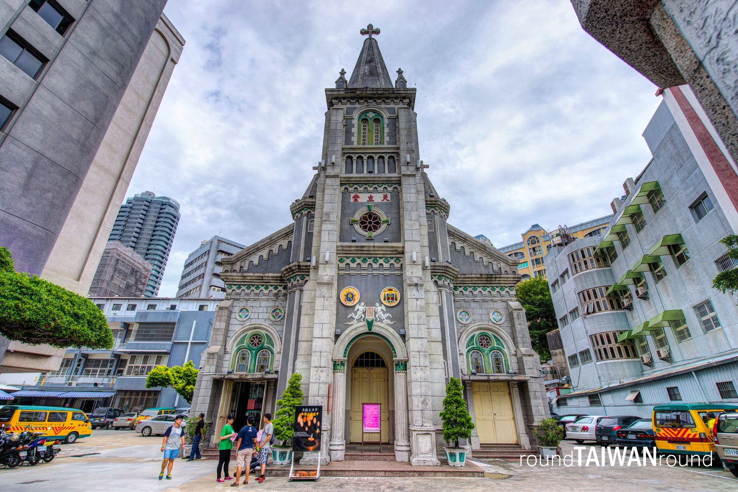
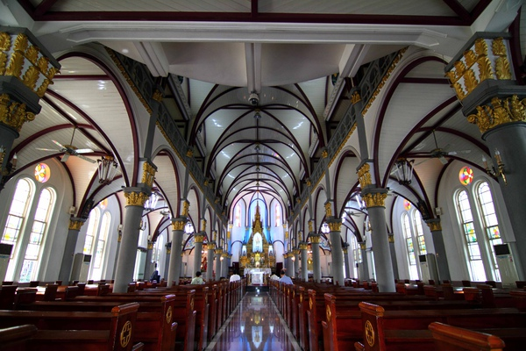
Holy Rosary Cathedral
The Holy Rosary Cathedral is the oldest Catholic church in Taiwan, located in Lingya District, Kaohsiung, just east of the Love River. It is the seat of the Bishop of Kaohsiung. The cathedral was first established in 1860 by Spanish from Filipinas and rebuilt to its present dimensions in 1928.

Slide 14
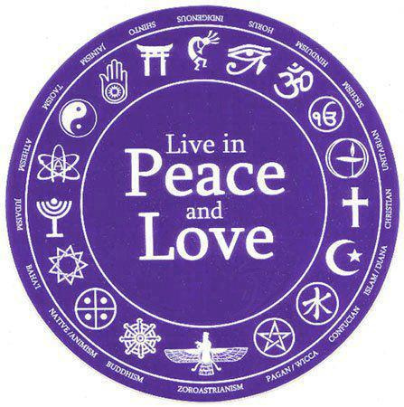
Peace
There are some others religions like Islam, Miledadao, Mormonism and others, but they are not such popular in Taiwan. Even there are many representatives of different religions and beliefs, people in Taiwan live in peace and they are tolerant to each other.

Slide 15
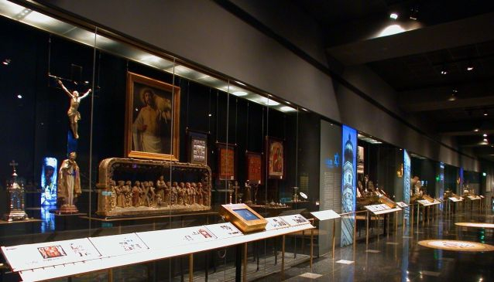
Museum of world religions
The Museum of World Religions is a museum in New Taipei. It was opened in 2001 by Hsin Tao.

Slide 16
Questions

