Slide 1
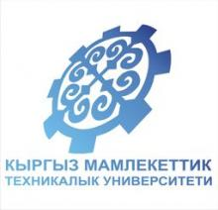
Kyrgyz State Technical University named after I.Razzakov Telematics Department
Governments in the Middle East
Bubusara Medralieva

Slide 2
“Middle East”: Unspecific British term
Area stretching from Libya in the west to Turkey in the north, to Yemen in the south, to Iran in the east (Sudan & Turkey are sometimes included)
With the exception of Turkey, Iran and Israel, all of these countries are part of the (22 members) League of Arab States, all the majority of citizens are Arabs.
Arabs = People whose first language is Arabic (≈ Hispanics in the U.S.)
Languages: Arabic, Hebrew, Farsi (Turkish?)
Most Arabs are Muslims (but many Arabs are Christian and Jewish, as in Lebanon, Syria, Egypt, and Palestine.
Main groups within the Islamic community are Sunni and Shiite.

Slide 3
Government Types – how do citizens participate?
Autocracy-- 1 person possesses unlimited power & citizens have limited role in government
Oligarchy-- small group exercises control & citizens have limited role in government
Democracy--supreme power is vested in the people & exercised by them directly or indirectly through a system of representation involving free elections
Theocracy--form of government in which a god is recognized as the supreme civil ruler. Religious institutional representatives often replace or mix into the civilian government.

Slide 4
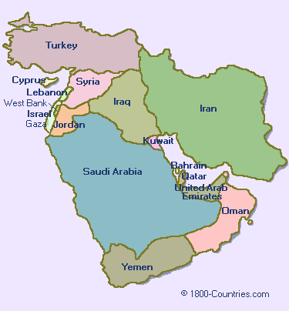
The Middle Eastern Governments
Democracy
Republic
Autocracy
Monarchy
Dictatorship
Oligarchy
Theocracy

Slide 5
The Middle Eastern Governments
 | Democracy | Monarchy | Dictatorship | Theocracy | Communism
Leaders take Power | Elected | Passed Down | Take power by force or are elected | Religious leaders are approved | By force or election of party
People’s Freedoms | Many | Vary | Few | Few | Few
Economic Control | Little government control | Vary | Control by Government | Control by government | Control by Government
Country with this government | Israel (A true Republic) | Saudi Arabia | Iraq (was), Sudan, North Korea | Iran, Afghanistan under the Taliban | Cuba

Slide 6
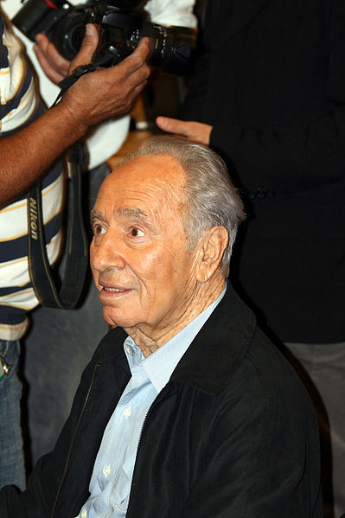
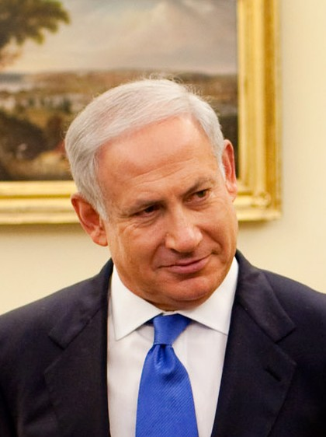
Israel
Parliamentary Democracy.
The president is head of state and serves in a primarily ceremonial role.
The prime minister is the head of government.
President is elected by the Parliament.
The President nominates the Prime Minister from a member of the parliament. (following a vote of confidence from the Knesset).
Citizens over 18 can vote for members of the unicameral legislature called the Knesset.

Slide 7
Israel
In 1948, the United Nations voted to divide the former British colony of Palestine into two parts.
One part became the nation of Israel, a homeland for the Jewish people.
The other part was for the Palestinian Arabs.
The governments of the countries in Southwest Asia often reflect Islamic beliefs, and Arabic people are often Islamic by faith.
The emergence of Israel as a Jewish nation became and still is a major political issue in the Middle East.

Slide 8
Israel
President: largely a ceremonial role and is elected by the Knesset for a seven-year term (one-term limit).
Prime Minister: serves a 5-year term; the President nominates a member of the Knesset and the other members vote on him/her. (Generally, the prime minister is usually the leader of the largest political party in the Knesset.)
Israel’s parliament is called the Knesset.
It is a unicameral governing body.
The Knesset passes all laws, elects the president & prime minister, and supervises the work of the government through its committees.
Israel does not have a formal constitution in place, but members of the Knesset have been working on one since 2003.

Slide 9
Israel
The Knesset Building, in Tel Aviv, is home to Israel’s government.

Slide 10
Israel
Although there is no formal constitution, a series of basic laws have the force of constitutional principles.
Freedom of the press is respected in Israel.
All Israeli newspapers are privately owned and freely criticize government policy.
The Israel Broadcasting Authority operates public radio and television services, and privately owned television networks and radio stations are widely available.
Most Israelis subscribe to cable or satellite television; internet access is widespread and unrestricted.

Slide 11
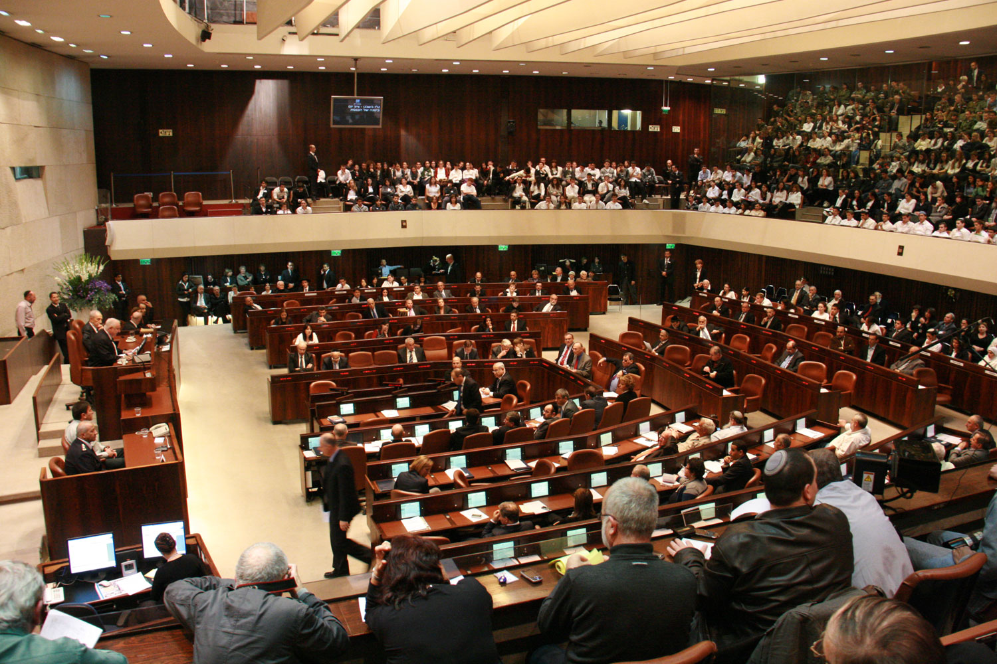
Israel
Knesset Chamber

Slide 12
Israel
Most Israeli citizens are required to serve in the Israel Defense Forces (IDF) for a period of between two and three years.
Israel is unique in that military service is compulsory for both males and females. It is the only country in the world that maintains obligatory military service for women.
All eligible men and women are drafted at age 18. Men serve for three years, women for 21 months.

Slide 13
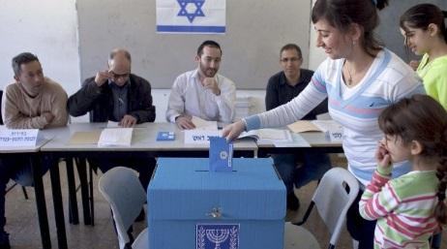
Israel
Voting in Israel

Slide 14
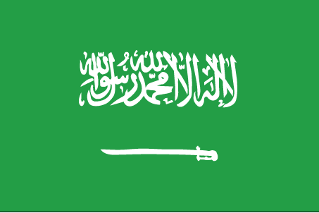
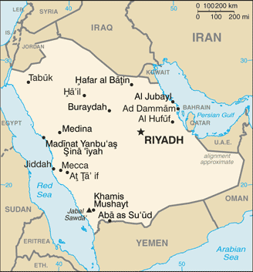
Kingdom of Saudi Arabia
Flag Description: green, a traditional color in Islamic flags, with the Shahada or Muslim creed in large white Arabic script (translated as "There is no god but God; Muhammad is the Messenger of God") above a white horizontal saber.

Slide 15
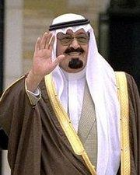
Kingdom of Saudi Arabia
Government Type: Monarchy - power is held by king or queen
Type of Leadership: King AND Prime Minister
Executive Power: King
Role of Citizen (Elections): None; the monarchy is hereditary

Slide 16
Kingdom of Saudi Arabia
Saudi Arabia had elections for city councils in 2005, giving Saudi men a limited opportunity to select some of their leaders at the local level.
Women were completely excluded from the election process.
The eligible electorate consisted of less than 20 percent of the population: male citizens who were at least 21 years old, not serving in the military, and a resident in their electoral district for at least a year.
Half of the council seats were open for election, and the other half were appointed by the monarchy.

Slide 17
Kingdom of Saudi Arabia
Justice in Saudi Arabia is administered by a system of religious courts according to the kingdom's strict interpretation of the Sharia law.
Sharia Law (Islamic law) - the moral code and religious law of Islam based on the Quran and the teachings of Muhammed. It is considered the law of Allah. Sharia deals with many topics addressed by secular law, including crime, politics, and economics, as well as personal matters such as hygiene, diet, prayer, and fasting.
Public punishment includes: stoning, amputation, flogging and hanging. The government tightly controls content in domestic media and controls regional print and satellite television coverage.
Members of the royal family own major shares in news outlets across the region.

Slide 18
Kingdom of Saudi Arabia
Saudi Arabia’s legislature is called the Consultative Council.
It can propose legislation to the king, but has no legal powers itself.
There are 150 members and a chairman that is chosen by the king to serve 4-year terms.
The king chooses two-thirds of the members of the Council, while men in the country vote for the remaining one-third of the members.
The Council mostly consists of members of the royal family.
In 2004, the Saudi government began allowing men who are 21 and older to vote for half of their local officials.
Men also vote for one-third of the members of the legislature.
There are no political parties in Saudi Arabia.

Slide 19
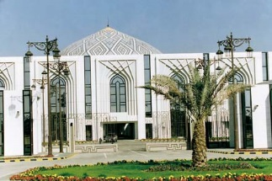
Kingdom of Saudi Arabia
Consultative Assembly of Saudi Arabia in Riyadh

Slide 20
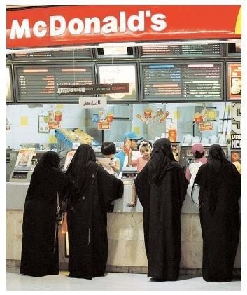
Kingdom of Saudi Arabia
Government officials have banned/punished journalists who publish articles deemed offensive to the country’s powerful religious establishment or the ruling authorities.
The government also limits the influence of new media, blocking access to some websites that are considered immoral or anti-Saudi.
Women are not allowed to drive.
Women must wear abaya at all times.
No gambling, alcohol, Western movies/tv
Restaurants have separate sections for men and women.
Everything stops for prayer 5 times a day.

Slide 21
Iran
Iran is a theocratic republic with a presidential system.
The government of Iran is based on Islamic law.
The Supreme Leader of Iran, who is a religious leader, is the chief of state and has final say on all matters.
The Supreme Leader is commander-in-chief of the armed forces.
The Supreme Leader is selected by the Council of Experts.
The Council of Experts, as well as the legislature and president, are elected by popular vote.
While the president is head of government, he may be removed by the Supreme Leader at any time.

Slide 22
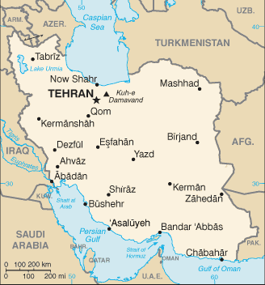
Iran
There is universal suffrage (voting) for everyone over 18.
The role of the citizen in Iran is to obey the Supreme Leader.
Flag Description: three equal horizontal bands of green (top), white, and red; the national emblem (a stylized representation of the word Allah in the shape of a tulip, a symbol of martyrdom) in red is centered in the white band; ALLAH AKBAR (God is Great) in white Arabic script is repeated 11 times along the bottom edge of the green band and 11 times along the top edge of the red band

Slide 23
Iran
In 1979, the Islamic (or Iranian) Revolution, overthrew the monarchy that had ruled Iran for centuries.
The Shah (king), who had been the monarch, had made Iran into a modern, less religious society.
Ayatollah Khomeini, who became Iran’s new leader, set up a religious dictatorship based on Islamic principles.
Supreme Leader: elected by the Assembly of Experts (88 elected people who are also charged with supervising the leader’s activities)
President: elected by the Iranian people and serves a 4-year term

Slide 24
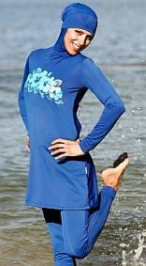
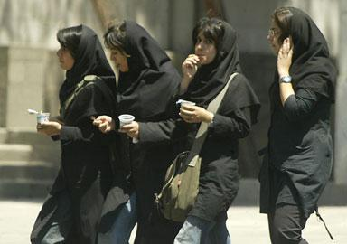
Iran
A woman cannot obtain a passport without the permission of her husband or a male relative.
Women do not enjoy equal rights under Sharia statutes governing divorce, inheritance, and child custody.
Women must follow dress codes and are sometimes segregated from men in most public places.

Slide 25
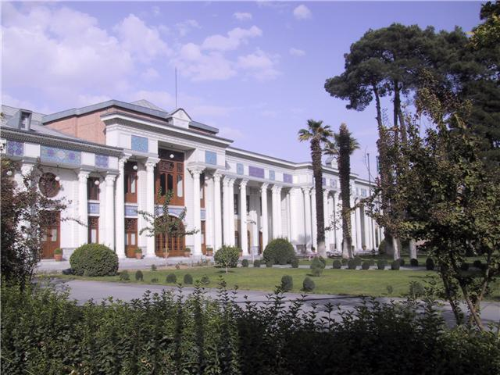
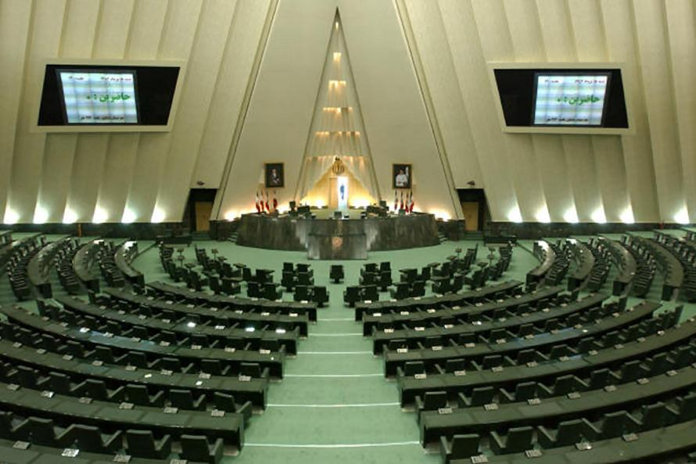
Islamic Consultative Assembly in Tehran, Iran

Slide 26
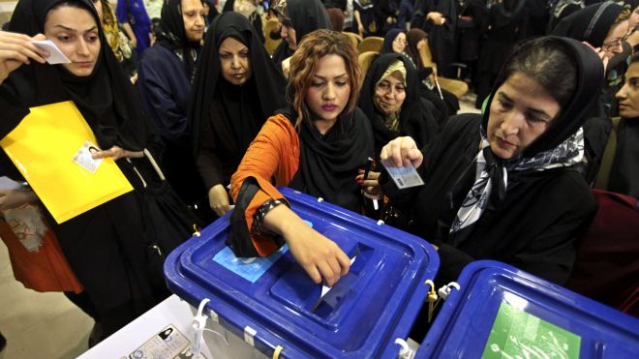
Voting in Iran

Slide 27
Thank you for Your Attention!

