Slide 1
Sights of Taiwan

Slide 2
Taiwan is a modern country that is developing rapidly, but retains its traditions and history. There are not very many old architectural structures left here, but those that appear to be visible forever in memory.

Slide 3
Skyscraper Taipei 101 This is the sixth tallest skyscraper in the world. It consists of 101 floors, which are located shops, restaurants, clubs. The height of the building is 509.2 meters. On the observation deck on the 89th floor, tourists take two high-speed elevators in just 39 seconds. These are the fastest elevators in the world. The design of the skyscraper is postmodern in combination with traditional motifs. The special design makes the skyscraper resistant to typhoons and earthquakes

Slide 4
Zsinmen Archipelago
This is an archipelago of six islands, located in the west of the Taiwan Strait. Its name translates as “Golden Gate”. They are close enough to Fujian province. The area of ​​the islands is just over 150 km². The biggest of them is Kinmen. It is home to a large part of the population. The archipelago was the site of the wars between China and Taiwan.

Slide 5
Chiang Kai-shek Memorial Hall This is a vivid example of temple architecture, the second most popular landmark in Taiwan. It was built in honor of former President Chiang Kai-shek. The complex includes the square, the National Concert Hall and the National Theater. And on the sides of the memorial hall are beautiful ponds. They were presented to the complex by General Ho In-Chin.

Slide 6
Sun Yat-sen Memorial Hall The essence of Yat-sen is considered the founder of the Chinese Republic, the Taiwanese are very revered. In his honor in 1972 a memorial hall was erected. It is located near the Taipei 101 skyscraper. The total area of ​​the building is almost 30 thousand m². In the memorial hall there is an exhibition center, a lecture hall, a library with more than 300 thousand books. The complex is surrounded by a park with an amazing lake.

Slide 7
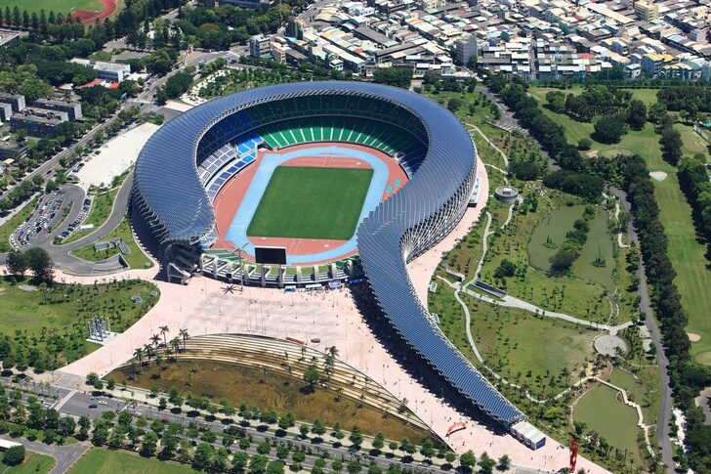
Kaohsiung National Stadium
This is the largest stadium of the island, which is located in the resort of Kaohsiung. It was built in 2009 in honor of the opening of the Olympic Games. Its capacity is 55 thousand people. The stadium was designed by architect Toyo Ito, and it is powered by solar panels, which are located on its front side. The shape of the stadium is unusual - spiral.

Slide 8
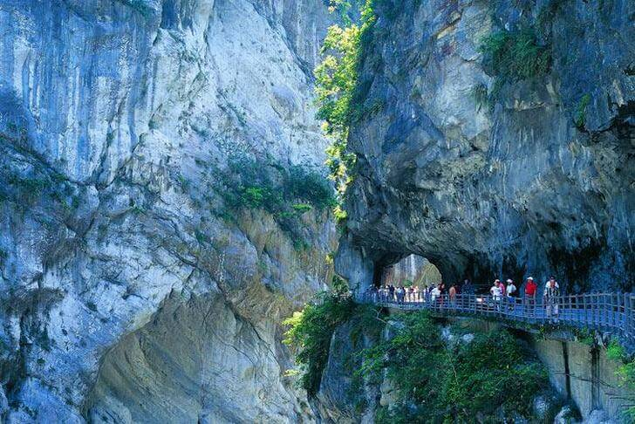
Taiwan is famous for its unique nature
U-Lin Farm
Taroko Reserve

Slide 9
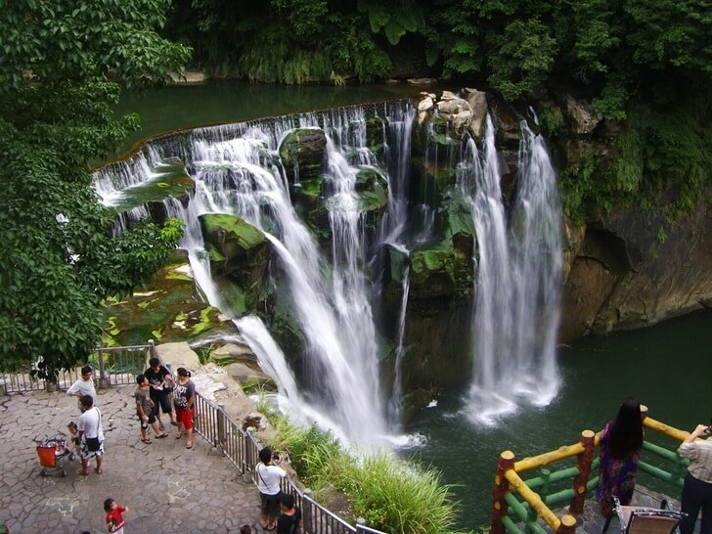
Yangmishan National Park
Shifen Falls

Slide 10
Mount Yushan This is the highest peak of East Asia. It is called the "roof" of Taiwan. The height of the mountain is 3952 meters. From its steep, steep slopes many large rivers originate. Climbing the mountain is not easy, the air is very discharged. But to conquer Yushan is an obligatory target for tourists. The reward for this will be incredible landscapes and a sense of unity with nature.
As in Kyrgyzstan, there are mountains in Taiwan, but they are not as high.

Slide 11
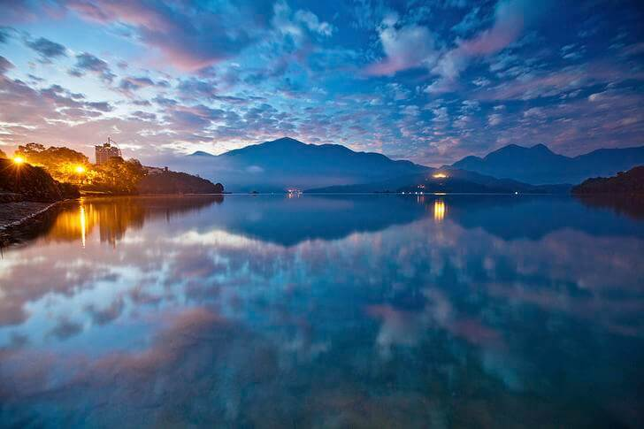
The lake of the Sun and moon An incredibly romantic place, suitable for honeymoon or privacy in a peaceful environment. It is one of the most picturesque places in Asia. There are a few hotels in the area and nothing else. The most beautiful lake is surrounded by green mountains. The emerald lake of Sun and moon is the largest in Taiwan. This is the best place to enjoy nature.

Slide 12
Thank you for your attention!!!

