Slide 1
Kyrgyz State Technical University named after I.Razzakov Telematics Department
Development and application of multimedia technologies in educational areas for Asia
Alymkulova Almina

Slide 2
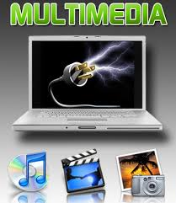
KEY WORDS
Technology of multimedia
Multimedia products
Sampling of a sound
Sound card
Effect of the movement
Multimedia Technologies (English multi -. Many, media - Wednesday). - This technology makes use of technical means and special software on the computer to combine text, graphics, audio and video information.

Slide 3
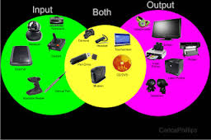
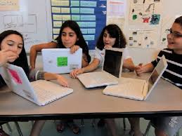
The notion of technology of multimedia
The term "multimedia" literally designates "many environments" and is treated as combination of the text, a sound, graphics and video in one information object
The technology of multimedia is the technology ensuring simultaneous functioning with a sound, videos, animations, static images and texts in the interactive (dialogue) mode.

Slide 4
The composition of multimedia: Hardware sound card, speakers, microphone, disk drives, CD-ROM, DVD-ROM software device drivers and audio playback software and video media multimedia data CD, DVD - discs.
The emergence of multimedia systems is made possible thanks to the progress in the development of PC: The increased volume of operational and external memory, processor speed, graphics capabilities, advances in video technology, laser discs, their mass introduction and development of effective methods of compression and scan data.

Slide 5
In the modern education system in Asia a huge role acquire information and pedagogical technologies of teaching, revealing the creativity, talent and personality of the individual. These include various types of training, monitoring programs, laboratory workshops, simulators, game programs, object-oriented environment, training simulations, role-playing, group workshops, case situations (case studies), multimedia technologies, psychological testing, etc.
Information technologies have opened real prospects for the education system, namely, the widespread introduction of means of information technologies for multimedia visualization, dynamic presentation of educational information with the use of video, audio and remote access to information resources; continuity and coherence of computer training at all levels of education - from pre-school to post-graduate - at the expense of computer support for all subjects and disciplines of the educational process; ensuring freedom of choice of technique, style, and learning tools for the detection and identification of individual creative abilities for the learner; the creation of scientific and methodologically sound basic education system on the basis of new information technologies.

Slide 6
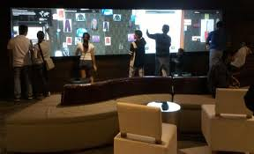
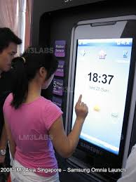
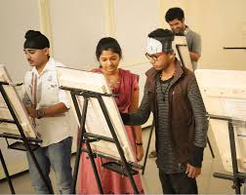
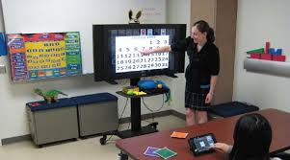
The level of use of computer technology in the majority of higher education institutions, while lagging behind the growth rates of computer hardware equipment and the pace of new technologies and software.

Slide 7
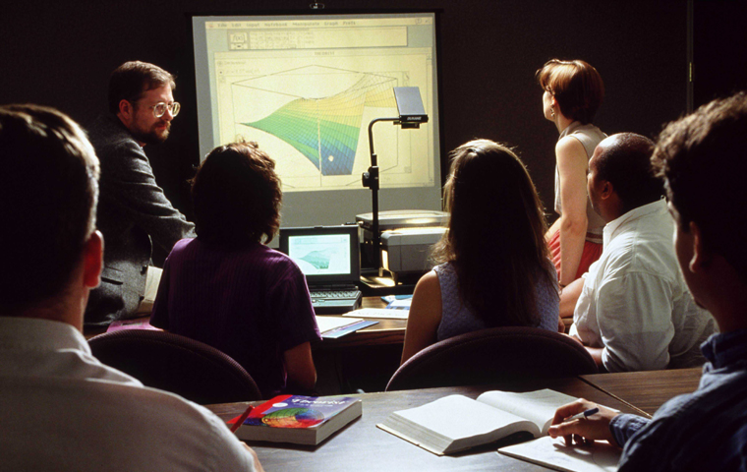
The feasibility of using multimedia in education can be illustrated by many examples. Example: As a rule, the presentation, accompanied by beautiful images and animations are more visually attractive than static text, and they can maintain a proper emotional level, complementing the submitted material, helping to improve learning efficiency.

Slide 8
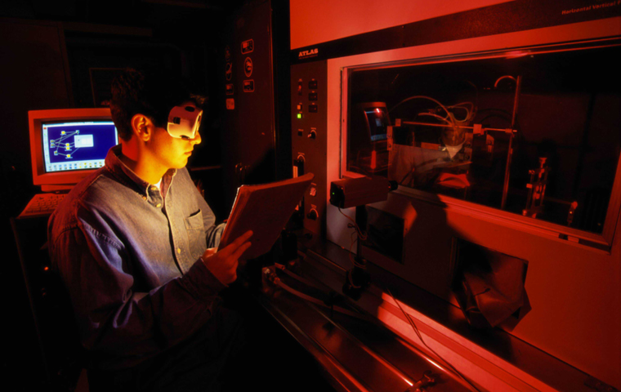
For example: Using Multimedia allows students to demonstrate a series of experiments in physics or chemistry, the implementation of which is impossible in the school environment.

Slide 9
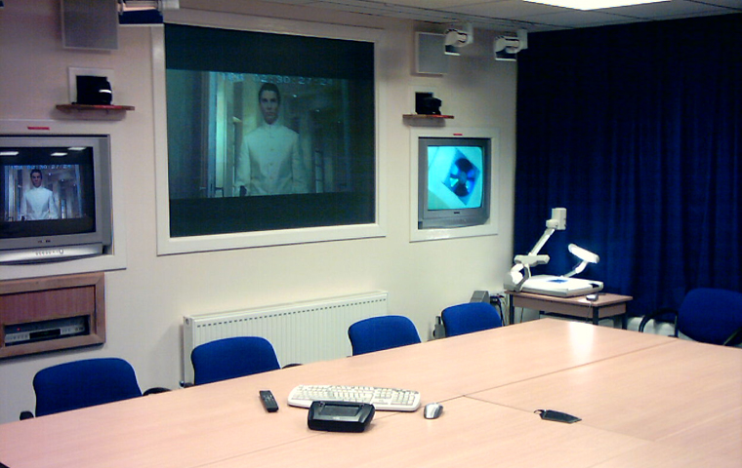
Example. With the using multimedia we can "move in space" and show the students studied in the course of history exhibits museums or archaeological sites, without having to leave the class.

Slide 10
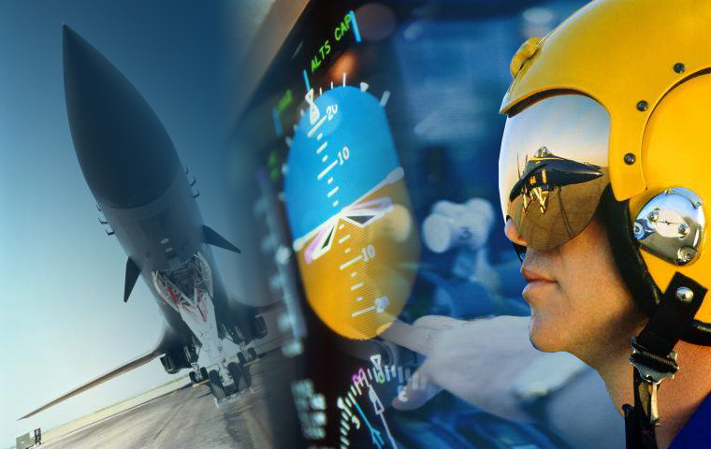
Example. Training of pilots in modern aircraft can not be done without special training to multimedia simulators that simulate real-life situations and require interaction with future pilot.

Slide 11
Working with multimedia tools, students can influence their own learning process, adjusting it to fit your individual abilities and preferences. They learn just the material that interests them, the study was repeated as many times as they need to, which contributes to a more correct perception.
Thus, the use of high-quality multimedia tools to make the process of learning flexible in relation to social and cultural differences between students, their individual styles and rates of learning and their interests. The use of media can a positive impact on several aspects of the educational process at university.
Media promotes:
1. Cheerleader cognitive aspects of learning, such as perception and awareness of information;
2. Increasing students motivation to learning;
3. Development of skills of teamwork and the collective knowledge of the trainees;
4. Development of the students more in-depth approach to learning, and involves the formation of a deeper understanding of the material being studied

Slide 12
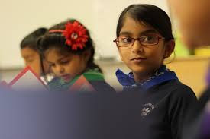
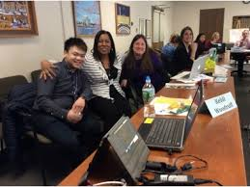
In addition to the number of advantages of using multimedia in general secondary education include:
simultaneous use of multiple channels of perception student in the learning process, this achieving the integration of information delivered in several different senses;
the ability to model complex, expensive or dangerous real experiments conducted in the school which is difficult or impossible;
visualization of abstract information through dynamic process;
visualization of objects and processes of micro- and macrocosm;
the opportunity to develop cognitive structures and interpreting students, framing the material studied in a broad academic, social, historical context, and linking the educational material with the interpretation of schoolchildren.

Slide 13
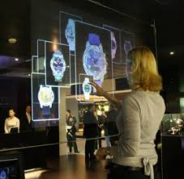
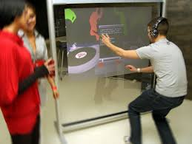
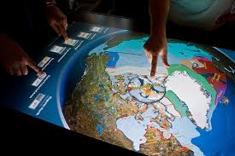
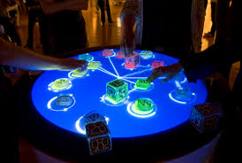
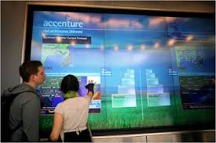
The use of computer multimedia technology in the teaching process raises it to a qualitatively new level, a positive effect on the motivation of students to educational activity, improves their viability and activity in the choice of methods for solving the tasks facing them.

Slide 14
Thank you for Your Attention!

