Slide 1
Kyrgyz State Technical University named after I.Razzakov Telematics Department
Development of telemedicine in Asia
Koshoeva Bibigul

Slide 2
What is telemedicine?
. . . the use of electronic information and communication technologies to provide and support health care when distance separates the participants . .
... medicine at a distance
i.e. any kind of medical activity where distance is involved
– diagnosis
– treatment
– education (staff or patient or general public)
Health care interactions – what are the alternatives?
• move the doctor* to the patient, e.g. a visiting or outreach service
• move the patient to the doctor, e.g patient transport
• facilitate a distance interaction

Slide 3
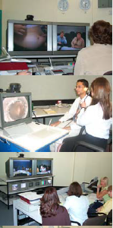
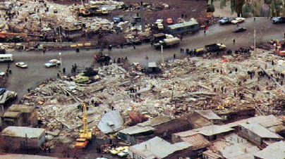
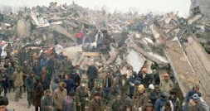
Telemedicine
• can be done using relatively simple and cheap techniques
– web
– email
• real time telemedicine (e.g. videoconferencing) works well in the right circumstances – but is expensive
Telemedicine for disaster relief
Armenian earthquake, 7 December 1988

Slide 4
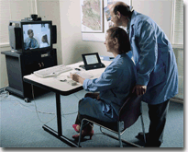
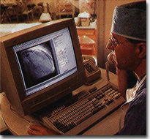
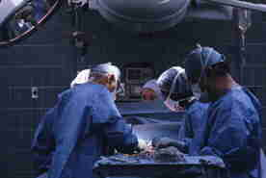
Telemedicine Applications
Remote Consultation
Remote Monitoring
Remote Education
Telementoring

Slide 5
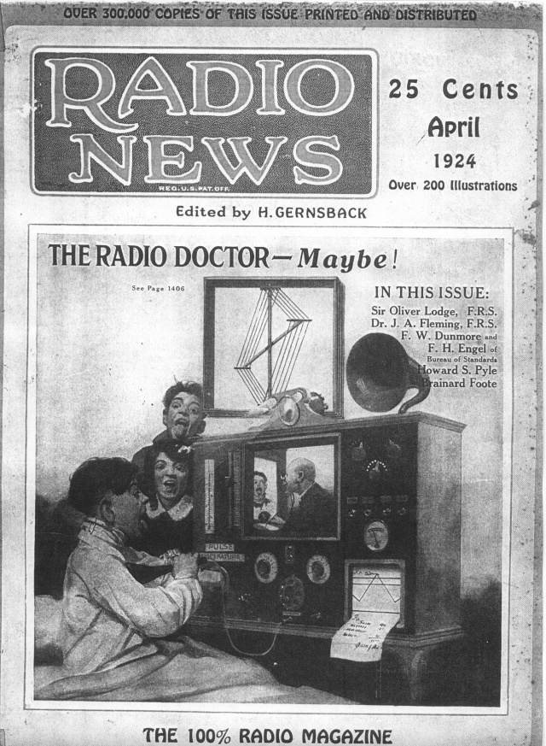
Telemedicine began . . .
In 1924, with the concept of a physician seeing his patient over the radio using a television screen
First wave of telemedicine programs started in the 1950s
Now in the third wave
Most programs that began in the 1960s-1980s no longer exist, due to dependence on external funding
Telemedicine now . . .
Doubling in number of two-way interactive video programs in 90s
Teleradiology, store-and-forward, remains most common application
Technology is rapidly changing and costs are decreasing
Correctional is heaviest use
Moving into private physicians use
Expanding applications

Slide 6
Basic Infrastructure At Remote Location
Laptop/desktop System
High End Camera
Pvx Licensed Software
Telemedicine Software
Diagnostic Equipment
Wireless/Wired Bandwidth

Slide 7
Advanced Infrastructure Telemedicine
Video Conference End points
Laptop/desktop System
Telemedicine Software
LCD Monitor /Projector
Diagnostic Equipment
Wireless/Wired Bandwidth

Slide 8
Conferencing Infrastructure for Telemedicine
MCU ( Multi Conferencing Unit)12/24/48…..
CMA/DMA (Application Management Software)
Recording ( DVD)
High Speed Bandwidth

Slide 9
The Polycom RMX 2000 real-time media conference platform delivers industry-firsts in quality, scale, and flexibility
Polycom RMX 2000
The Polycom DMA solution is a powerful network-based application that manages and distributes multipoint video calls within a large organization and provides redundancy, reliability, and efficiency of video services
Polycom DMA 7000
The CMA provides centralized endpoint management, scheduling, reporting and an intuitive, secure video soft-client that connects to any standards-based immersive suite, conference room, or video endpoint.
Polycom CMA 5000
The Polycom Video Media Center (VMC) 1000 solution is a complete, scaleable video-on-demand content management system and live broadcast/streaming solution
Polycom VMC 1000

Slide 10
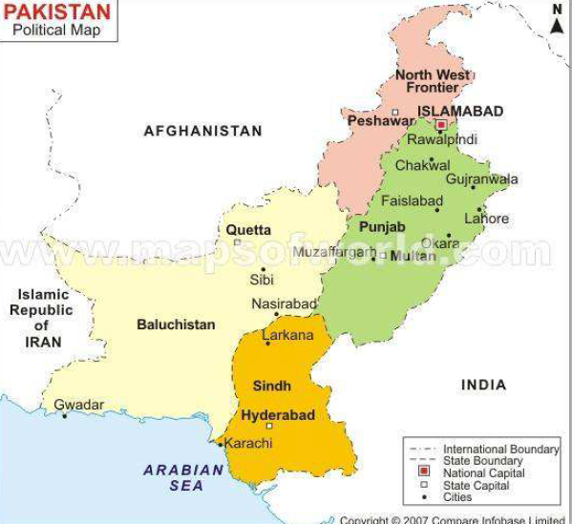
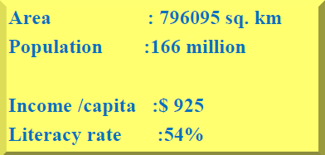
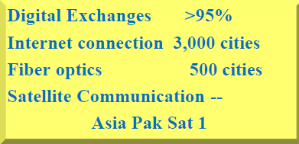
Telemedicine, Examples from Pakistan

Slide 11
History of Telemedicine Initiatives in Pakistan
Early focus on using telemedicine for expanding healthcare to rural Pakistan started in 2000.
• Mostly NGOs introduced the concept through some local Hospitals as partners.
• Rudimentary store and forward tele-consultation setups were done to start with.
• Government interest started in 2005 with the availability of multiple sources of bandwidth including the national satellite.
• Integrated policy framework is in the works in parallel with the full-scale pilot projects for real time remote consultations through network enabled medical equipment at remote end.

Slide 12
PAKSAT-HealthNET Project
The project is designed to offer Basic telemedicine services including
– Tele-diagnosis/consultations: Specialists in hub hospitals will be able to examine patients remotely and provide diagnosis and consultations
– Tele-treatment: Patients diagnosed with a disease or their doctor will be able to seek specialist advice on treatment to be offered
• Diseases covered will include ENT, skin, chest, cardiology, psychiatry
– Specialists will be able to examine the patients, their medical history, test results and vital signs like heartbeat, blood pressure, temperature, breathing etc thorugh electronic medical facilities available at remotes

Slide 13
PAKSAT-HealthNET Project
PAKSAT-HealthNET is designed as a pilot project to set-up a telemedicine infrastructure linking three urban hospitals with twelve hospitals in rural/remote areas
• Number of rural sites proposed to be covered in each province under this project are as follows
– PUNJAB1 (Holy Family) » (Attock, Khushab, D.G Khan & Pindi-Gheb)
– PUNJAB2 (Mayo) » (Gujrat, Sahiwal, Rajanpur, Jhang)
– SIND (JPMC) » (Shikarpur, Mirpurkhas, Ghambat, Jacobabad)
PAKSAT-HealthNET will comprise of hubs and each hub is to be connected to 4 rural hospitals (remotes) • Mayo, JPMC and Holy Family have been identified as hubs because these are already involved in telemedicine projects and specialists working there have the domain experience, thereby ensuring faster ramp-up of the project by reducing training requirements at hubs • The remotes can be district or tehsil level hospitals

Slide 14
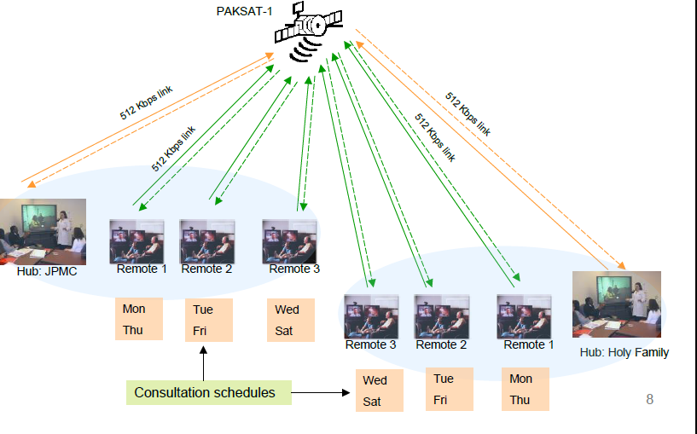

Slide 15
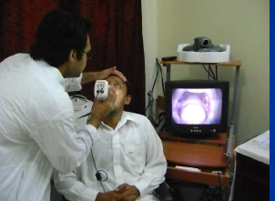
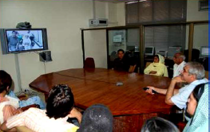
National Telemedicine Projects Initiated :
• Multitasking of telemedicine center
• MOIT – Telemedicine Rural Support Program
• Pak –US Collaboration – Pakistan Telemedicine project
• Tele-Pathology project approved- 2008-9
• (Holy Family – Harvard )
• Tele –Oncology
• Role in Disaster Management: Earthquake / Floods

Slide 16
Telemedicine/E-health training center at HFH
Telemedicine/E-health Training Center
Training of 100 Doctors and Nurses
Number of Institutes benefited
Implementation of Telemedicine programs
Role in Disaster Management
Mobile Telemedicine Units
( ITU, INTEL, PASHA, MOIT)
Telemedicine Training of Paraplegics
Research and Development Activities

Slide 17
Telemedicine Training of Doctors Nurses

Slide 18
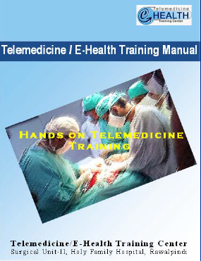
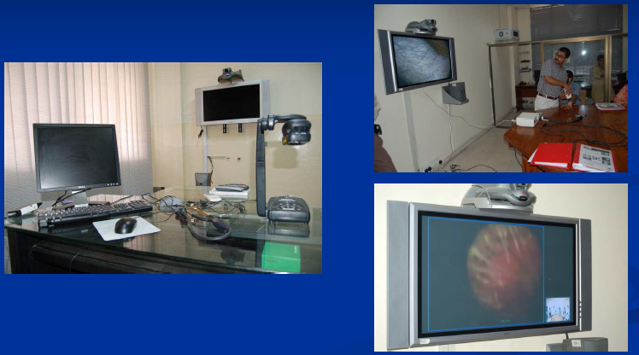
Facilities at all centers
www.telemedicine.pk

Slide 19
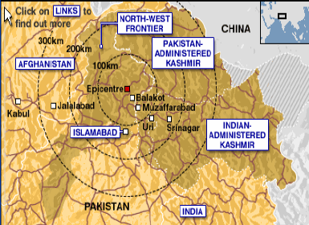
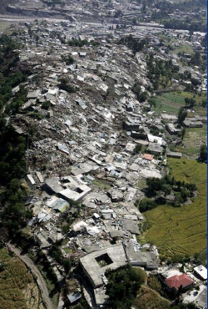
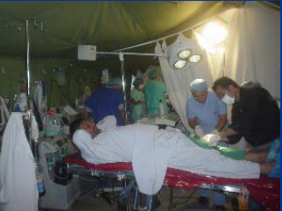
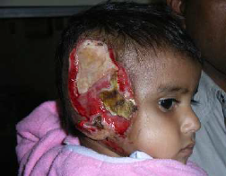
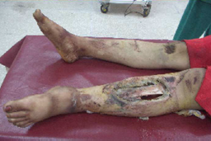
Role of Telemedicine
E-health Center in Disaster
Earthquake: Pakistan 2005

Slide 20
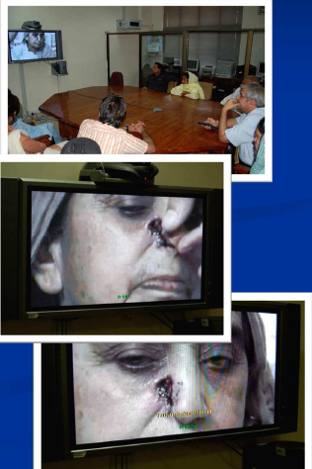
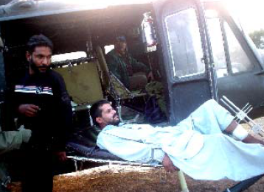
Telemedicine – Role in disaster Management
Multitasking
Hub at Holy family hospital (Tertiary Care)
Remote centers in disaster area
Step down hospitals
Follow up
Rehabilitation

Slide 21
Thank you for your attention!!!

